Slide 1
THE NORTH RIDGEVILLE CHURCH OF CHRIST
Scripture taken from the New King James Version®.
Copyright © 1982 by Thomas Nelson. Used by permission. All rights reserved.

Slide 2
A Critical Review of Premillennialism
THE RESURRECTION

Slide 3
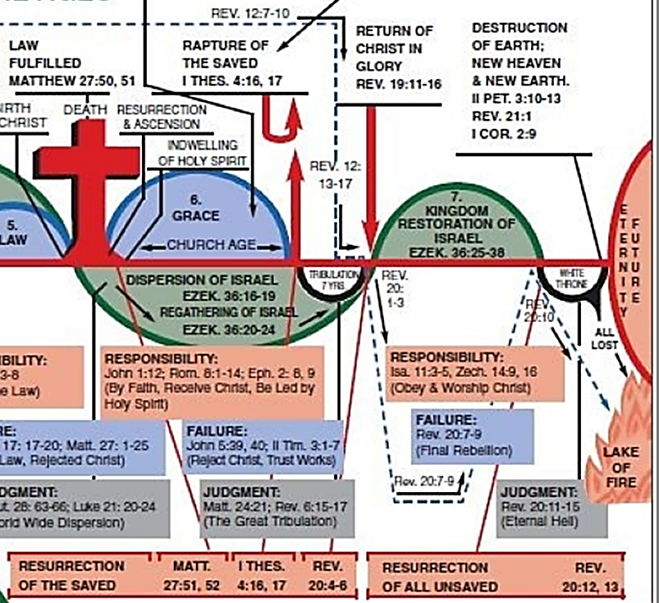
Multiple RESURRECTIONS?
4 Resurrections

Slide 4
ANSWERS
An hour when all who are in their graves will hear and come forth – Jn. 5:28, 29
“A resurrection of the dead” – Acts 24:15
There are as many future ages as there are future resurrections – Lk. 20:33-36

Slide 5
Luke 20:33-36
“THIS AGE” | “THAT AGE”
Marry, given in marriage, die | Do not marry, do not die, are like the angels of God, being sons of the resurrection
RESURRECTION

Slide 6
ANSWERS
An hour when all who are in their graves will hear and come forth – Jn. 5:28, 29
“A resurrection of the dead” – Acts 24:15
As many future ages as there are future resurrections – Lk. 20:33-36
The Day of Christ – 2 Thess. 2:1, 2

Slide 7
2 Thessalonians 2:1, 2
Now, brethren, concerning the coming of our Lord Jesus Christ and our gathering together to Him, we ask you, not to be soon shaken in mind or troubled, either by spirit or by word or by letter, as if from us, as though the day of Christ had come.

Slide 8
OBJECTION !!!
Multiple Resurrections in Revelation 20:4-6

Slide 9
Revelation 20:4-6
First Resurrection (v. 5) → Second Resurrection
Second Death (v. 6) → First Death
IDENTITY: Slain saints of 6:9-11 from “under the altar” to living and reigning with Christ
These
implies
Not Hurt by This (v 6)!

Slide 10
Revelation 20:4-6
International Children’s Bible
The second resurrection!
⁵ (The others that were dead did not live again until the 1,000 years were ended.) This is the first raising of the dead. ⁶ Blessed and holy are those who share in this first raising of the dead. The second death has no power over them. They will be priests for God and for Christ. They will rule with him for 1,000 years.

Slide 11
“The sea gave up the dead who were in it, and Death and Hades delivered up the dead who were in them. And they were judged, each one according to his works.”
REVELATION 20:13

Slide 12
IS YOUR NAME WRITTEN IN THE BOOK OF LIFE?
Not those who practice false worship – 13:8
Not those who marvel over anti-Christian efforts – 17:8 (contrast, 1:8)
Not those who add to and take away from the word of God – 22:18, 19

Slide 13
IS YOUR NAME WRITTEN IN THE BOOK OF LIFE?
Obeyed the books (Rev. 20:12-15)?
Washed in the blood of the Lamb (Rev. 1:5; 5:9; 7:14; 12:11)?
Washed in baptism (Acts 22:16)?
What if faith/works die (Rev. 3:1-5)?

