Slide 1



I Have Played The Fool

Slide 2
How Might We
Abandoning the Gospel for the Law of Moses or Pagan Practices
Despising A Father’s Instruction
Hearing But Doing Nothing
PLAY THE FOOL TODAY?
Being Wise In Your Own Eyes
Trusting In Earthly Riches

Slide 3

Those who say, “There is no God.”
6
Psalm 14:1,
“The fool has said in his heart, ‘There is no God.’”
Psalm 19:1,
“The heavens declare the glory of God; And the firmament shows His handiwork.”

Slide 4

The Watch and Watchmaker
Parts formed
Parts framed (any other arrangement results in failure)
Material: metal (enhances the effect, work, efficacy)
All parts tuned and regulated to produce motion which points out the hour of the day
Each part has a purpose which contributes to the whole
Design
Purpose
“…the inference, we think, is inevitable, that the watch must have had a maker; that there must have existed, at some time, and at some place or other, an artificer or artificers who formed it for the purpose which we find it actually to answer; who comprehended its construction, and designed its use…” (William Paley, 1743-1805)

Slide 5

The Watch and Watchmaker
Would It Weaken the Inference If:
I have never seen a watch made?
The watch sometimes went wrong?
I didn’t understand what some parts contributed?
The majority of my peers rejected it?
Someone wearing a white lab coat asserted the watch was the product of natural law?
“…the inference, we think, is inevitable, that the watch must have had a maker; that there must have existed, at some time, and at some place or other, an artificer or artificers who formed it for the purpose which we find it actually to answer; who comprehended its construction, and designed its use…” (William Paley, 1743-1805)C

Slide 6
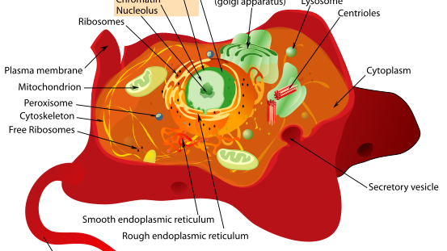
What About:
The orderly and timely intra-cellular mechanism of life?
    You are not here simply because you “developed!”
    You are not here simply because trillions of successful transactions occurred.
    Who built the “system” within you that allowed you to develop?

Slide 7
William Paley (1743-1805)
“Every indication of contrivance, every manifestation of design, which existed in the watch, exists in the works of nature; with the difference, on the side of nature, of being greater and more, and that in a degree which exceeds all computation. I mean that the contrivances of nature surpass the contrivances of art, in the complexity, subtlety, and curiosity of the mechanism; and still more, if possible, do they go beyond them in number and variety; yet in a multitude of cases, are not less evidently mechanical, not less evidently contrivances, not less evidently accommodated to their end, or suited to their office, than are the most perfect productions of human ingenuity…”

Slide 8
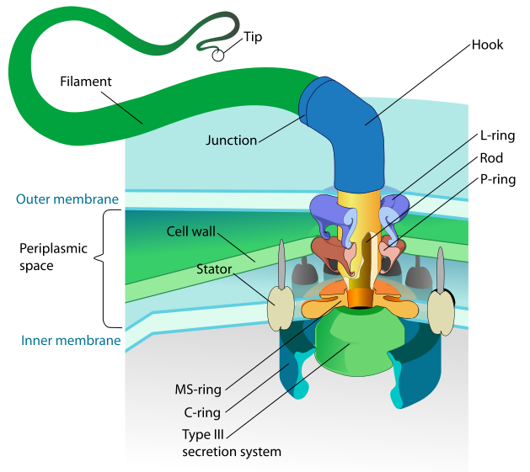
And Paley didn’t know of this…
Bacterial Flagellum
Movement discovered in the 1970s
Screams intelligence
Irreducibly complex
Isa 44:24 “Thus says the LORD, your Redeemer, And He who formed you from the womb: ‘I am the LORD, who makes all things…’”
http://en.wikipedia.org/wiki/Image:Flagellum_base_diagram.svg

Slide 9
Romans 1:20
“For since the creation of the world His invisible attributes are clearly seen, being understood by the things that are made, even His eternal power and Godhead, so that they are without excuse”

Slide 10
Psalm 102:25-27
25 Of old You laid the foundation of the earth,
And the heavens are the work of Your hands.
26 They will perish, but You will endure;
Yes, they will all grow old like a garment;
Like a cloak You will change them,
And they will be changed.
27 But You are the same,
And Your years will have no end.

Slide 11
Romans 14:11-12
For it is written:
“As I live, says the LORD,
Every knee shall bow to Me,
And every tongue shall confess to God.”
¹² So then each of us shall give account of himself to God.

Slide 12

“Prepare To Meet Your God”
Amos 4:12
Believe – Jn. 8:24
01
Repent – Lk. 13:3
02
Confess – Matt. 10:32-33
03
Be Baptized – Mk. 16:16
04
Be Faithful – Rev. 2:10
05
“Prepare To Meet Your God”
Amos 4:12

