Slide 1



I Have Played The Fool

Slide 2
How Might We
PLAY THE FOOL TODAY?
Mixing Moses’ Law into Gospel Law – Galatians 3:1-3
Despising a Father’s Instruction – Proverbs 15:5
Hearing and Doing Nothing – Matthew 7:24-27
Being Wise in Your Own Eyes – Proverbs 26:12

Slide 3
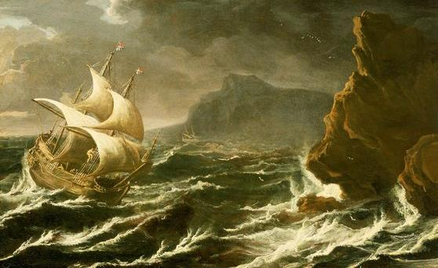

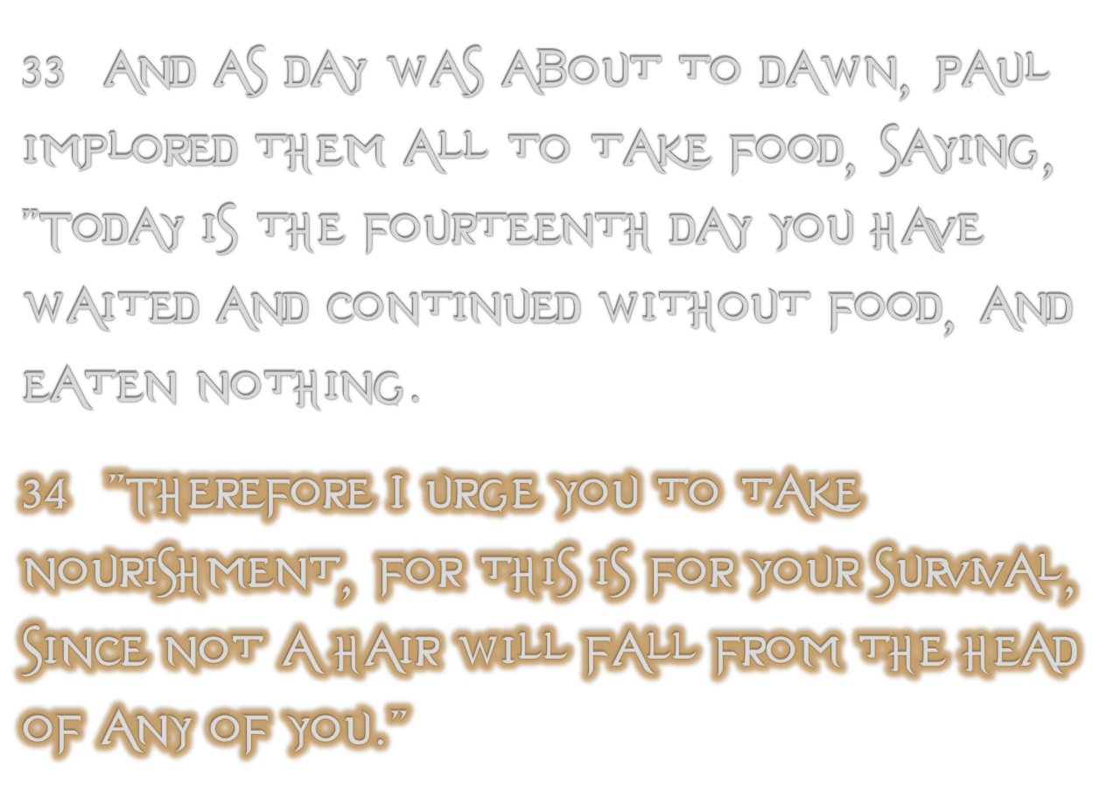
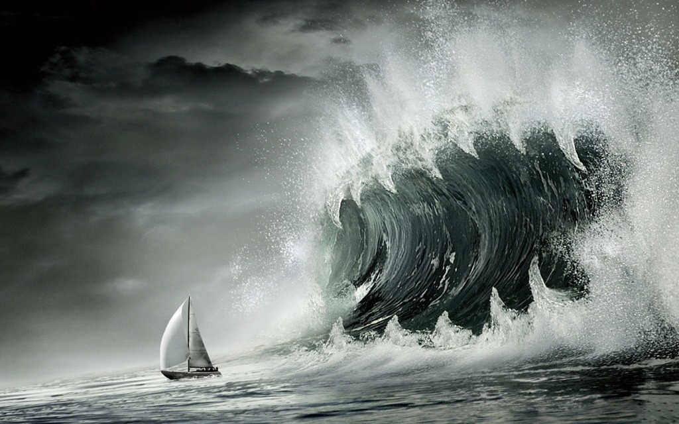


Slide 4

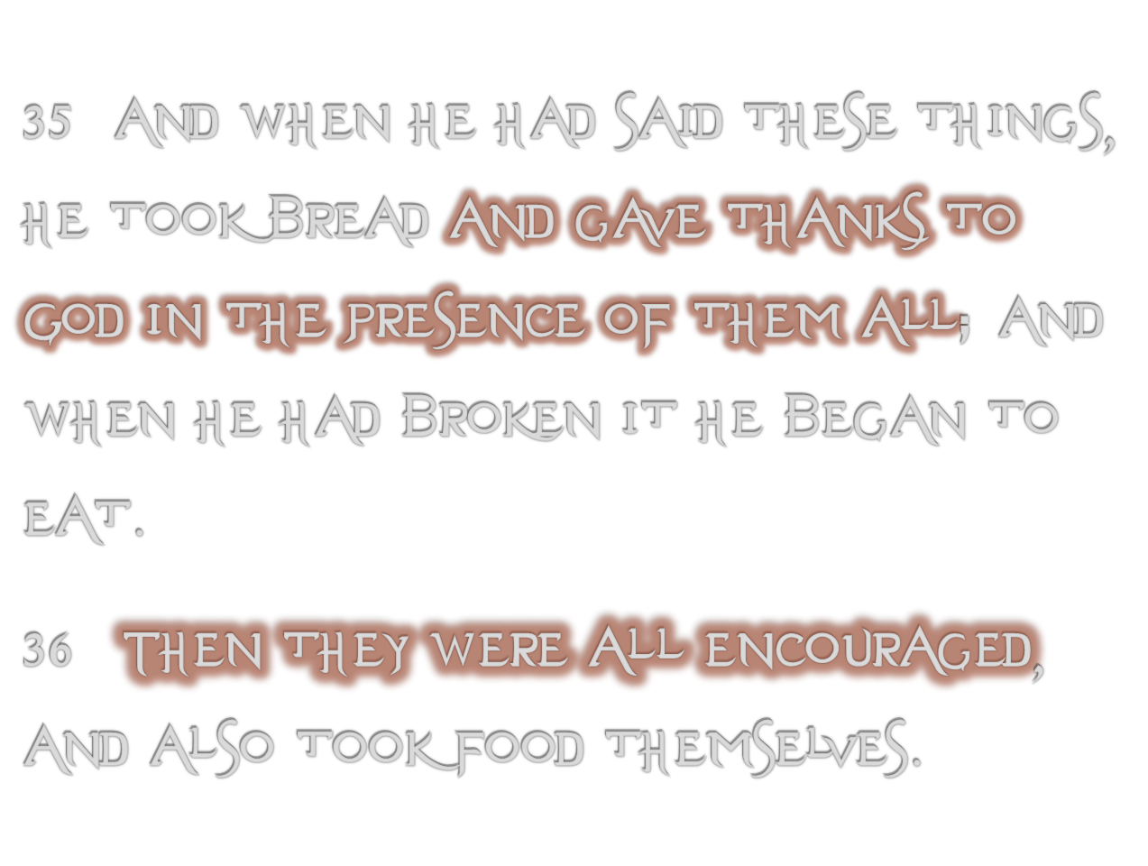

Slide 5
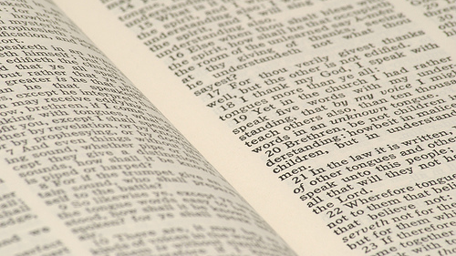
One Who Trusts in Earthly Riches
5
Psalm 49:6-20
  The limitations of wealth (6-9)
  The limitlessness of death (10-14)
  The liberation from the grave (15-20)

Slide 6


REALITIES about RI¢H€$
Can become a powerful temptation (1 Tim. 6:9)
A person’s true life does not consist in the abundance of (Lk. 12:15; Rev. 2:9)
Any living person who makes gold his god honors that which he must separate (Psa. 49:17; 1 Tim. 6:7)

Slide 7
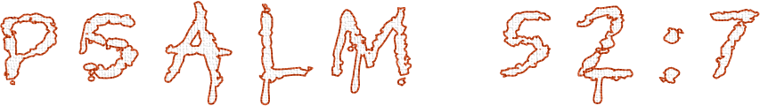

REALITIES about RI¢H€$
The abundance of earthly riches cannot supply the smallest need of the soul
Death strips away all material accomplishments leaving only the soul standing before a jealous God—Lk. 12:16-21

Slide 8
Proverbs 8:12-21
¹² I, wisdom, dwell with prudence, And find out knowledge and discretion. … ¹⁷ I love those who love me, And those who seek me diligently will find me. ¹⁸ Riches and honor are with me, Enduring riches and righteousness. ¹⁹ My fruit is better than gold, yes, than fine gold, And my revenue than choice silver. ²⁰ I traverse the way of righteousness, In the midst of the paths of justice, ²¹ That I may cause those who love me to inherit wealth, That I may fill their treasuries.

Slide 9
How Might We
PLAY THE FOOL TODAY?
Mixing Moses’ Law into Gospel Law – Galatians 3:1-3
Despising a Father’s Instruction – Proverbs 15:5
Hearing and Doing Nothing – Matthew 7:24-27
Being Wise in Your Own Eyes – Proverbs 26:12
Trusting in Earthly Riches – Psalm 49:6-20

