Slide 1


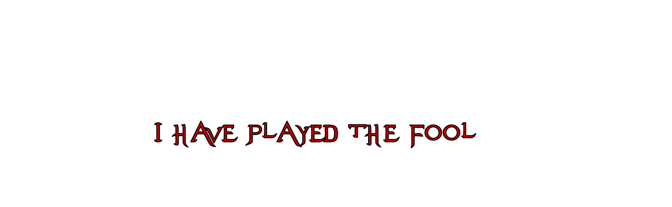
I Have Played The Fool

Slide 2
How Might We
PLAY THE FOOL TODAY?

Slide 3
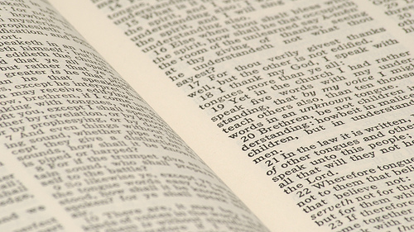
Abandoning the Gospel for the Law of Moses
1
¹ O foolish Galatians! Who has bewitched you that you should not obey the truth, before whose eyes Jesus Christ was clearly portrayed among you as crucified?
² This only I want to learn from you: Did you receive the Spirit by the works of the law, or by the hearing of faith?
³ Are you so foolish? Having begun in the Spirit, are you now being made perfect by the flesh?
Galatians 3:1-3
O foolish Galatians!

Slide 4
A Man Who Despises His Father’s Instruction
2
“A fool despises his father’s instruction, But he who receives correction is prudent.”
Proverbs 15:5
“A wise son heeds his father’s instruction, But a scoffer does not listen to rebuke.”
Proverbs 13:1

Slide 5
One Who Hears But Does Nothing
3
Matthew 7:24-27
  Two different people: wise and foolish
  Both build houses
  Both hear same message
  Both undergo the same storms
  One remains while the other falls

Slide 6
A Man Wise In His Own Eyes
4
“Do you see a man wise in his own eyes? There is more hope for a fool than for him.”
Proverbs 26:12

Slide 7

Proverbs 12:15
The way of a fool is right in his own eyes, But he who heeds counsel is wise.
Proverbs 28:26
He who trusts in his own heart is a fool, But whoever walks wisely will be delivered.
Proverbs 14:12
There is a way that seems right to a man, But its end is the way of death.

Slide 8


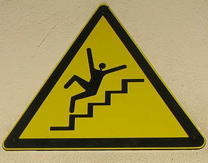

Jeremiah 10:23
O LORD, I know the way of man is not in himself; It is not in man who walks to direct his own steps.
Isaiah 55:8-9
For My thoughts are not your thoughts, Nor are your ways My ways,” says the LORD.
For as the heavens are higher than the earth, So are My ways higher than your ways, And My thoughts than your thoughts.

Slide 9

Isaiah 26:7
“The way of the just is uprightness; O Most Upright, You weigh the path of the just”
“God does not judge by the magnitude of an act, but by the spiritual principles and motives which lie back of the act. A small action may discover and lay bare these principles quite as well as a large one. In the administration of small properties entrusted to us on the earth we reveal our disposition and temper as stewards quite as well as if we owned half the universe”
(J. W. McGarvey, TFG, on Luke 16:10-14)

Slide 10
The Wise Prepare To Meet God
Matthew 24:42-44
Matthew 25:1-13

