Slide 1
Does God Approve Of Tobacco Use For Christians?
Part 2
“Therefore do not be unwise, but understand what the will of the Lord is” (Eph. 5:17)

Slide 2
When Issues Arise:
Abstain from being emotionally charged
(Jas. 1:19, 20)
Possess a sound mind (2 Tim. 1:7)
Look into God’s word for guidance (Prov. 3:5, 6; Ps. 119:105; Jas. 1:21, 25)
  Work from the pattern of sound words (2 Tim. 1:13)
Be objectively reflective—set your heart to understand (2 Tim. 2:7; Dan. 10:12; Eph. 5:17)

Slide 3
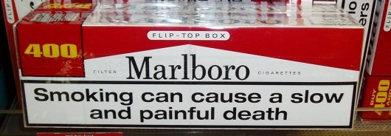


Smoking?
GOOD?
OR
BAD?
"For a good tree does not bear bad fruit, nor does a bad tree bear good fruit” (Lk. 6:43)

Slide 4
21st Century Tobacco Use
Between 2010 and 2014 smoking caused
Nearly half a million premature deaths a year
More than 87% of all lung cancer deaths
61% of all pulmonary deaths
32% of all coronary deaths

Slide 5
New Cancer Findings
TWO more cancers are caused by smoking:
Liver cancer
Colorectal cancer –
the second deadliest
behind lung cancer
SMOKING keeps cancer
treatments from working
as well as they should.

Slide 6
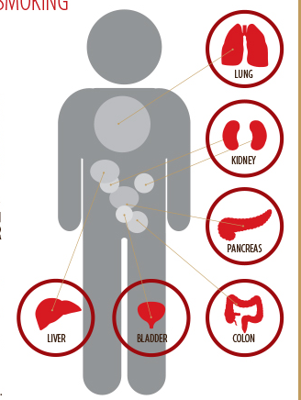
Smoking – The Breath Blocker
Chronic Obstructive Pulmonary Disease (COPD)
Smoking causes most
cases of COPD.
There is NO CURE for COPD

Slide 7
Smoking – The Breath Blocker
COPD rates have risen steadily since 1964.
Nearly 8 out of 10 COPD deaths are from smoking.
COPD patients have higher risk for lung cancer and heart disease.
Women who smoke are now dying from COPD in the same numbers as men who smoke.

Slide 8
People in the World
Recognize it is Bad
Surgeons and health professionals
  Hospitals shifting from “smoking ban” to “smoker ban”
  “…hospitals in Florida, Georgia, Massachusetts, Missouri, Ohio, Pennsylvania, Tennessee and Texas, among others, stopped hiring smokers…” (www.nytimes.com/2011/02/11/us/11smoking.html?pagewanted=all&_r=0)

Slide 9
People in the World
Recognize it is Bad
Surgeons and health professionals
Businesses
  Alaskan Airlines require nicotine test prior to hiring workers
  Union Pacific will not hire smokers

Slide 10
People in the World
Recognize it is Bad
Surgeons and health professionals
Businesses
Leading cigarette manufacturer Philip Morris
  “Philip Morris USA agrees with the overwhelming medical and scientific consensus that cigarette smoking causes lung cancer, heart disease, emphysema and other serious diseases in smokers. Smokers are far more likely to develop serious diseases, like lung cancer, than non-smokers. There is no safe cigarette” (www.philipmorrisusa.com/en/cms/Products/Cigarettes/Health_Issues/default.aspx?src=top_nav)

Slide 11
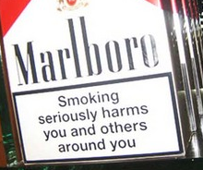
The Principle of
“LOVE”
“Love does no harm to a neighbor; therefore love is the fulfillment of the law” (Rom. 13:10)
  2.5 million Americans have died from SHS from
  1964-2014
  Exposure to SHS at home or work increase your chance to get heart disease by 25-30 percent; lung cancer by 20-30 percent; SIDS, asthma attacks, etc.
  How does the fruit of smoking “love your neighbor?”

Slide 12

Which Poison Is More Lethal?
Arsenic
Strychnine
Nicotine

Slide 13
Other Things To Consider:
Your body (1 Cor. 6:19, 20; 10:31; Rom. 12:1)
  Will this help you glorify God in your body?
  Will this help you present your body as a living sacrifice that is holy and acceptable?
  “Nicotine is one of the quickest and most fatal poisons known to man. One or two drops, or a solution of 1 part nicotine to 1000 parts solvent, placed on a dog's gum will result in death within 30 seconds”
  (Kenneth Hirshey, “Smoke,” TRUTH MAGAZINE XIII: 8, pp. 10-12
  May 1969, truthmagazine.com/archives/volume13/TM013178.html)

Slide 14
Other Things To Consider:
Your influence
(2 Cor. 3:2, 3; Rom. 14:7; Matt. 5:14-16)
  Will this help you win others to Christ?
  Will this help edify or destroy your brethren?
  Principle: “Therefore do not let your good be spoken of as evil” (Rom. 14:16)?

Slide 15
Influence
“According to ‘The Time to Stop Cigarette Smoking is Now!’ Pamphlet which is published by the American Cancer Society, 29 percent of the boys smoke when neither parent smokes. However, when one of the parents smokes, that figure is raised to 37 percent, and when both parents smoke the figure jumps to 44 percent. For girls, the statistics show that those smoking are 16 percent, 29 percent, and 37 percent respectively for the same groupings. Thus, the need that Jesus taught for living an exemplary life is shown once again (Matt. 5:13; Phil. 2:15)”
(Mike Willis, “More Evidence On Smoking,” TRUTH MAGAZINE XIV; 47, pp. 8-10. October 8, 1970)

Slide 16
Other Things To Consider:
Your conscience (Heb. 13:18; 2 Cor. 1:12)
  Use tobacco with godly sincerity? No objection for the spouse, children, and grandchildren to take it up?
  No objection for elders, deacons, preachers, bible class teachers to take it up?
  “Finally, brethren, whatever things are true, whatever things are noble, whatever things are just, whatever things are pure, whatever things are lovely, whatever things are of good report, if there is any virtue and if there is anything praiseworthy—meditate on these things” (Phil. 4:8)

Slide 17
Other Things To Consider:
Your stewardship (1 Cor. 4:1, 2)
  Tobacco use is expensive!
  1 pack a day = $2014.80 a year ($5.52 X 365)
  Is the cost (personal and financial) justifiable as a a good steward?
  Does it take away from what your family needs?

Slide 18
Other Things To Consider:
Your self-control (1 Cor. 6:12; 9:27; Titus 1:8; Gal. 5:19-23; 2 Pet. 2:19)
  Smoking is “addicting”
    “Philip Morris USA agrees with the overwhelming medical and scientific consensus that cigarette smoking is addictive. It can be very difficult to quit smoking, but this should not deter smokers who want to quit from trying to do so” (www.philipmorrisusa.com)
  “Addiction” defies “self-control”

Slide 19
Other Things To Consider:
Your self-control (1 Cor. 6:12; 9:27; Titus 1:8; Gal. 5:19-23; 2 Pet. 2:19)
  Must break free from whatever evil may allure and entangle us (fear, beer, drugs, porn, gossip, quick tempered, materialism, etc.)
  How can we reason about “self-control” with others if we are addicted to anything (Acts 24:25)?

Slide 20
Joe Price
(www.bibleanswer.com/2003_Vol_07_No_09_27Jul.htm#news)
“The body of the Christian is to be an instrument of righteousness in the service of God (Rom. 6:13). Therefore, one is to not allow sin to “reign in your mortal body, that you should obey it in its lusts” (Rom. 6:12). …Cigarette smoking harms the body and hastens death. And, the addictive nature of cigarette smoking tries and overcomes the self-control of millions. The fruit of the Spirit is self-control, not the lustful addiction to a product that causes lung disease, heart disease and cancer.”

Slide 21
You CAN Quit!
  “To reduce the health effects of cigarette smoking, the best thing to do is to quit” (www.philipmorrisusa.com)
“It can be difficult to quit cigarette smoking, and many smokers who try to quit do not succeed. Millions of smokers in the U.S. and around the world have succeeded, however, using a variety of methods” (ibid.)
www.smokefree.gov

Slide 22
This Lesson
Is intended to help everyone by providing what is informative (Acts 20:20)
Is given with only good in mind so as to become a messenger of the whole counsel of God (Acts 20:26, 27)
Is to chasten in love with the hope to save, not put to death (Ps. 118:14-18; Eph. 4:15)

Slide 23
1 Corinthians 3:16, 17
¹⁶ Do you not know that you are the temple of God and that the
Spirit of God dwells in you?
¹⁷ If anyone defiles the temple of God, God will destroy him. For the temple of God is holy, which temple you are.
THE CHURCH
(cf. 3:9)
THE INDIVIDUAL

Slide 24
Proverbs 3:5-8
⁵ Trust in the LORD with all your heart, And lean not on your own understanding;
⁶ In all your ways acknowledge Him, And He shall direct your paths.
⁷ Do not be wise in your own eyes; Fear the LORD and depart from evil.
⁸ It will be health to your flesh, And strength to your bones.

