Slide 1
Does God Approve Of Tobacco Use For Christians?
“Therefore do not be unwise, but understand what the will of the Lord is” (Eph. 5:17)
Notes:
Charts 9, 13-18 are from the Center For Disease Control.
Intro with God’ calling us out of the world to be His special treasure (Titus 2:11-15).

Slide 2
When Issues Arise:
Abstain from being emotionally charged
(Jas. 1:19, 20)
Possess a sound mind (2 Tim. 1:7)
Look into God’s word for guidance (Prov. 3:5, 6; Ps. 119:105; Jas. 1:21, 25)
  Work from the pattern of sound words (2 Tim. 1:13)
Be objectively reflective—set your heart to understand (2 Tim. 2:7; Dan. 10:12; Eph. 5:17)
Notes:
4. Compare the spirit of Acts 15:6

Slide 3
How To Objectively Answer Our Question:
Does it overtly violate an explicit commandment?
Does it violate principles found in God’s word which are to govern the Christian?
  Example: DANCING
  Bible does not say, “Do not dance!”
  Violation of principles:
    Incitement of sensual thoughts (Mk. 6:21, 22)
    Lewd/lasciviousness (Gal. 5:19)
    No biblical scene approving men and women socially handling each other (cf. Ex. 32:19, 6, 25)
Notes:
Thayer on LASCIVIOUSNESS, “Unbridled lust, excess, licentiousness, lasciviousness, wantonness, outrageousness, shamelessness, insolence, wanton (acts or) manners, as filthy words, indecent bodily movements, unchaste handling of males and females, etc.”
We could condemn similar things like porn, filthy movies, magazines, etc. on the same account because it violates these principles.

Slide 4
How To Objectively Answer Our Question:
Questions:
  Is the fruit good or bad?
  Can you promote it as good?
  Harmful to influence, stewardship, health?
  Addictive?
  Does it promote righteousness?
  Does it agree with the example of Christ?
  Can you thank God for it (Col. 3:17)?

Slide 5
Notable Quote
(Don Potts, “King Nicotine or King Jesus?” TRUTH MAGAZINE XX: 40, pp. 635-636. October 7, 1976)
“One of the most common evils and gripping habits one can deal with, is the use of tobacco. Brethren also know that it is one of the touchiest subjects a preacher can deal with. For this reason, preachers have learned to leave it alone, declaring that it will do no good to preach on the matter. Could it be what they mean to say is, it will do them no good? It is strange how preachers can lift their bold (?) voices against some sin that no one in a hundred miles is guilty of, or scold the young people for writing notes or chewing gum in services, but never seem to get around to reproving the sins of those who put the bread on his table! "Do I now persuade men, or God? or do I seek to please men? for if I yet pleased men, I should not be the servant of Christ" (Gal. 1:10).”

Slide 6
Syllogism of Sin
(Don Potts, “King Nicotine or King Jesus?” TRUTH MAGAZINE XX: 40, pp. 635-636. October 7, 1976)
It is sinful to harm the physical body
The use of tobacco Is harmful to the physical body
Therefore, the use of tobacco in human consumption is sinful
Notes:
Brother Potts went on to argue a syllogism. Point 1: see 1 Cor. 6:19, 20.
That this harm was known for over six decades is seen in a quote from Dr. Alton Ochsner, noted cancer expert, founder and director of surgery of the Ochsner Foundation Hospital and professor of clinical surgery at Tulane University in New Orleans, and author of the book, “Smoking: Your Choice Between Life And Death,” said, “Each cigarette he smokes he shortens his life 34.6 minutes. 'The pack a day smoker pays with 11 1/2 hours for each pack he smokes." "Habitual cigarette smoking, is suicidal." (Houston Post, Tuesday, July 21, 1959, National Insider, Vol. 7, No. 1, July 4, 145).

Slide 7
Principle of Fruit
“Even so, every good tree bears good fruit, but a bad tree bears bad fruit. A good tree cannot bear bad fruit, nor can a bad tree bear good fruit. Every tree that does not bear good fruit is cut down and thrown into the fire” (Matt. 7:17-19)
Notes:
Same principle to consider the latter end. “Oh, that they were wise, that they understood this, That they would consider their latter end!” (Deut. 32:29)

Slide 8
Principle of Fruit
“Either make the tree good and its fruit good, or else make the tree bad and its fruit bad; for a tree is known by its fruit” (Matt. 12:33)
  Judge by fruit inspection
  A tree is known by its fruit
Notes:
A tree is not judged here by its leaves or its form, but by what it bears. The fruit that it bears determines its quality. This is a good principle for people to use in determining whether something is good or bad. Simply look at the fruit of it.
Now the context here is that men had labeled Jesus as corrupt by attributing His works as coming from Beelzebub (12:24). They judged Him being in league with Satan. But if His doctrine and works were not corrupt, then their charge is corrupt—in fact blasphemy! And so in realty of judging a good tree as bad, they are the ones in reality who are in work with Satan for their fruit showed them to be brood of vipers (12:34).

Slide 9
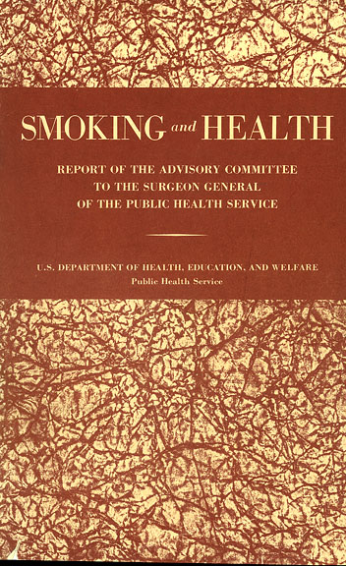
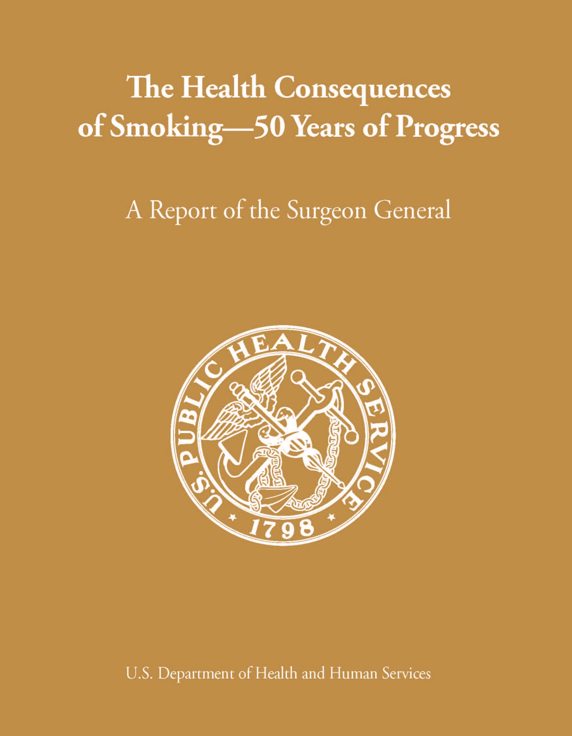
The Health Consequences of Smoking:
50 Years of Progress
A Report of the Surgeon General
1964
2014
Notes:
Fifty years ago Dr. Luther Terry shocked the nation when he released the first Surgeon General’s report that linked smoking to lung cancer and heart disease. In January, the 32nd Surgeon General’s Report on smoking and health was released. The new report provides more evidence of the serious damage smoking does to the human body. It also commemorates the anniversary of that first report that laid the foundation for today’s programs to reduce the disease and death caused by smoking.

Slide 10
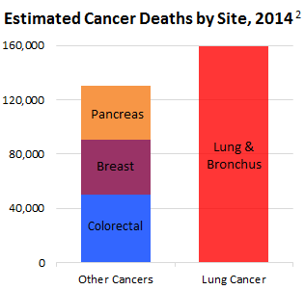
Stats & Facts
www.lung.org/lung-disease/lung-cancer/resources/facts-figures/lung-cancer-fact-sheet.html
Notes:
Lung cancer is the leading cancer killer in both men and women in the United States. In 1987, it surpassed breast cancer to become the leading cause of cancer deaths in women.¹
Lung cancer causes more deaths than the next three most common cancers combined (colon, breast and pancreatic). An estimated 159,260 Americans are expected to die from lung cancer in 2014, accounting for approximately 27 percent of all cancer deaths.²
Lung cancer is the most common cancer worldwide, accounting for 1.37 million deaths annually. Cancer accounted for 7.6 million deaths annually, or about 13 percent of the total worldwide deaths.⁶
In 2010, Kentucky had the highest age-adjusted lung cancer incidence rates in both men (121.7 per 100,000) and women (79.6 per 100,000). Utah had the lowest age-adjusted cancer incidence rates in both men and women (30.5 per 100,000 and 23.6 per 100,000, respectively).⁵ These state-specific rates were parallel to smoking prevalence rates.

Slide 11
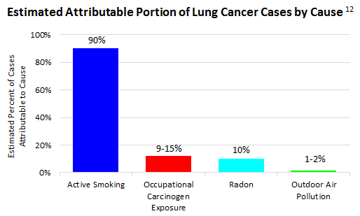
Stats & Facts
www.lung.org/lung-disease/lung-cancer/resources/facts-figures/lung-cancer-fact-sheet.html
Notes:
“It has been estimated that active smoking is responsible for close to 90 percent of lung cancer cases; radon causes 10 percent, occupational exposures to carcinogens account for approximately 9 to 15 percent and outdoor air pollution 1 to 2 percent. Because of the interactions between exposures, the combined attributable risk for lung cancer can exceed 100 percent.¹²”
Men who smoke are 23 times more likely to develop lung cancer. Women are 13 times more likely, compared to never smokers.⁹
Between 2005 and 2010, an average of 130,659 Americans (74,300 men and 56,359 women) died of smoking-attributable lung cancer each year.

Slide 12
Stats & Facts
Estimated Annual Lung Cancer Cost in the U.S.
  $12.1 billion in lung cancer care (2010)
  $36.1 billion in lost productivity due to early death
  ___________
  = 48.2 billion
  × ~90% = $43.8 billion (tobacco caused lung cancer)
www.lung.org/lung-disease/lung-cancer/resources/facts-figures/lung-cancer-fact-sheet.html
Notes:
So and estimated 43.8 billion dollars is wasted each year in America alone due to just one disease that is made 90% of time caused by smoking cigarettes. Of all cancers, lung cancer is the most preventable! So it is needless cost and needless early death. Does that sound good to you?

Slide 13
The Grim Statistics
Between 1964 and 2014:
Over 20 million Americans died because of smoking, including
  2.5 million nonsmokers
  More than 100,000 babies
Smoking is still the leading cause of preventable disease and death in the United States.
Notes:
Smoking has been called “the persistent epidemic.” Why? Because unlike most health epidemics, smoking and the health effects caused by smoking have been part of the American experience since our earliest beginnings as a nation.
Over time science has shown that people who smoke cigarettes are much more likely to develop – and die from – certain diseases than people who don’t smoke. And despite Dr. Terry’s warning, more than 20 million Americans have died from smoking since the that first report in 1964.
Most of these deaths were of adults with a history of smoking but two and a half million were of nonsmokers who died because they breathed air that was polluted by other people’s cigarette smoke.
More than 100,000 of the smoking-related deaths were of babies who died from Sudden Infant Death Syndrome or other health conditions caused by parental smoking, particularly by the mother.
Despite these sad and sobering numbers, smoking is still the leading cause of preventable disease and death in the nation.

Slide 14
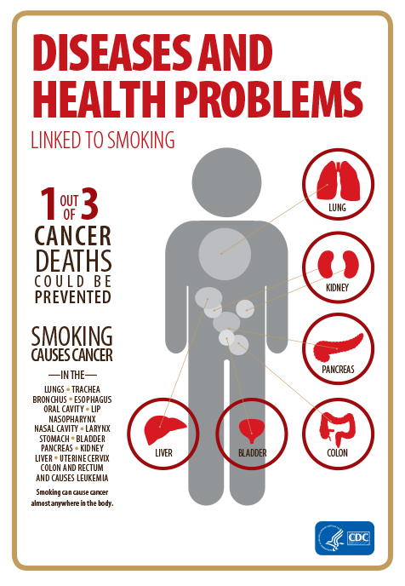
Smoking – The Cancer Trigger
Smoking is now known to cause
13 different types of cancer—
almost everywhere in the body.
1 out of 3 U.S. cancer deaths
are tobacco-related.
Notes:
Lung cancer is not the only cancer known to be caused by smoking. In fact, today we know that smoking causes cancer almost anywhere in the body.
When you smoke, chemicals immediately cause damage to the cells in your body. Over time these damaged cells grow uncontrollably in the body. These cells grow into tumors that damage organs and can spread to other parts of the body. Nearly all lung cancer – the number-one cancer killer of both men and women – is caused by smoking.
If no one in the United States smoked, we could prevent one out of three cancer deaths.

Slide 15
What We’ve Learned
The Killer Cigarette
Smoking risks are more deadly than 50 years ago.
Smokers inhale over 7,000 chemical
compounds.
At least 70 CAUSE
CANCER.
Notes:
The tobacco industry is largely to blame for those 20 million deaths. Tobacco companies have spent billions of dollars refining and marketing the cigarette. As a result, cigarettes have become more deadly and more addictive over these past 50 years.
The danger of smoking comes from inhaling chemical compounds, some in the tobacco and some that are created when tobacco is burned. The process used to make modern cigarettes includes the use of many harmful chemicals.
In all, scientists have identified more than 7,000 chemicals and chemical compounds in tobacco smoke. At least 70 of them are known to cause cancer.
Some of those chemicals speed and enhance the absorption of nicotine – which is the primary agent in tobacco that causes addiction.

Slide 16
What We’ve Learned
The Killer Cigarette
Smoking causes disease in nearly every organ.
Secondhand smoke kills more than 41,000 nonsmokers every year.
There is no safe level of SHS exposure and NO SAFE CIGARETTE.
Notes:
The reason cigarette smoking is so deadly is that it causes disease in nearly every organ of the body.
Being around an active smoker also presents a significant health risk to those who do not smoke. Why? Secondhand smoke contains the same toxins that active smokers inhale and it kills more than 41 thousand nonsmokers a year in this country.
The science in 50 years of Surgeon General’s Reports has also removed notion that there might be such a thing as a “safe” cigarette. All cigarettes are harmful, and any exposure to tobacco smoke can cause both immediate and long-term damage to the body. Bottom line: There is no safe level of exposure to tobacco smoke, and there is no safe cigarette!

Slide 17
Smoking – The Heart Stopper
Smoking causes cells lining veins and arteries to swell.
Narrower arteries mean
reduced blood flow to the
heart, brain, and organs.
Clots can block narrowed
arteries, causing heart attack,
stroke, and even sudden
death.
Even occasional smoking
damages blood vessels.
Notes:
Most of the conditions that make up cardiovascular disease are caused or made worse by smoking.
Chemicals in cigarette smoke cause the cells that line blood vessels to swell, and the opening in blood vessels to become more narrow. The longer you smoke, and the more cigarettes you smoke, the more serious the damage.
But even new smokers, or people who only smoke a few cigarettes a day, are at risk. Autopsy studies have shown that the early signs of cardiovascular disease appear in young adults who began smoking as teenagers.

Slide 18
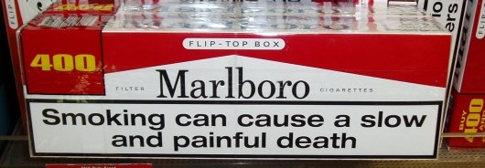


Smoking?
GOOD?
OR
BAD?
"For a good tree does not bear bad fruit, nor does a bad tree bear good fruit” (Lk. 6:43)
Notes:
Compare 1 Samuel 12:20-25 for invitation.
When sin, do not leave the Lord. These people had done wickedly. But they were not to walk away from the Lord but rather repent and serve Him with all heart (12:20, 21)
God wants you. He is pleased to make you His own special people (20:22)
Do we want Samuels among us (20:23)? Cf. 1 Cor. 3:21-4:2.
Fear, serve in truth, consider what great things He has done for you (20:24).
Do not persist in sin (20:25).

