Slide 1
Institutionalism & The Church (1)
“But He answered and said, ‘Every plant which My heavenly Father has not planted will be uprooted’” (Matt. 15:13)

Slide 2

“Institutionalism,” A Definition
The church of Christ as a religious organization composed of individual congregations which collectively carry out a spiritual or social work through a designated institution (college, home, church, etc.)
church
church
church
FUND$
Organization
WORK
church
church
church
Institutional Concept

Slide 3
The 1800’s & INSTITUTIONALISM

Slide 4
1849 Missionary Concept
church
church
church
FUND$
Missionary
Society
Evangelism
church
church
church
Alexander Campbell’s
Concept
Derailed the restoration movement
Disrupted unity and promoted denominationalism
Determined pressure on churches and preachers to join

Slide 5
1849 Missionary Concept
church
church
church
FUND$
Missionary
Society
Evangelism
church
church
church
Alexander Campbell’s
Concept
Infected a diseased approach to scripture which helped lead to the breakdown of authority and contamination of worship with instrumental music (1859, Midway KY)

Slide 6
The EVOLUTION Of Denominationalism
What Led To The Formation of The American Christian Missionary Society?
1831-32 “The Cooperation of Churches,” published by A. Campbell
Wellsburg Cooperation Meeting of County Churches, April 12, 1834
Statewide Cooperation Meetings, 1840’s
A. Campbell authored 16 articles on “The Nature of the Christian Organization” (1841-43) – proposing a general organization of churches, a “body” must have “organization”
1845, American Christian Bible Society, Cincinnati, OH
1849, American Christian Missionary Society, Cincinnati, OH

Slide 7
Instrumental Music Followed Institutionalism
Institutionalism
Instrumental Music
Violated rule of faith (Rom. 10:17)
  No mention of churches building anything other than churches
Added To The Work
  Building something extra to do the work of the church
Doesn’t say “not to!”
Local church insufficient to do her work
Justified as an expedient
Violated rule of faith (Rom. 10:17)
  No mention of praise with anything other than the heart and lips
Added To The Worship
  Using something extra to do the worship of the church
Doesn’t say “not to!”
A cappella worship is insufficient for praise
Justified as an expedient

Slide 8
COMPARED TO:
“To the law and to the testimony! If they do not speak according to this word, it is because there is no light in them”
(Is. 8:20)
“If anyone speaks, let him speak as the oracles of God” (1 Pet. 4:11)
“So then faith comes by hearing, and hearing by the word of God” (Rom. 10:17)
“Test all things; hold fast what is good” (1 Thess. 5:21)

Slide 9
COMPARED TO:
“God is Spirit, and those who worship Him must worship in spirit and truth” (Jn. 4:24)
“These things we also speak, not in words which man’s wisdom teaches but which the Holy Spirit teaches, comparing spiritual things with spiritual” (1 Cor. 2:13)
“… that you may learn in us not to think beyond what is written…” (1 Cor. 4:6)

Slide 10
COMPROMISE ➔ MORE COMPROMISE
Compromise in one area…sow seeds of compromise in another
Compromise on creation…the Creator
Compromise on the work of the church…the worship of the church
Compromise on the nature of the leadership of the church (qualifications of elders and deacons)…the direction of the church
Compromise the work of a gospel preacher…the message of/to the church
Compromise on God’s law of exclusion…the plan of entrance
Compromise on sin → morality→ grace
Compromise on doctrine → idolatry → immorality

Slide 11
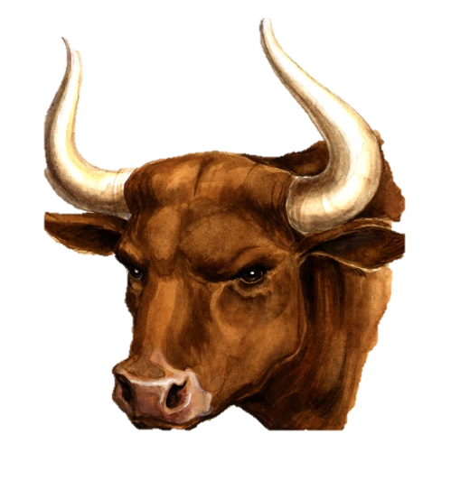
Let Us Never Compromise Truth With Error
“Our livestock also shall go with us; not a hoof shall be left behind. For we must take some of them to serve the LORD our God, and even we do not know with what we must serve the LORD until we arrive there” (Ex. 10:26)

