Slide 1
Divine Responsibilities
Regarding The Family
“Why do you turn and scrape every stone to gather wealth and take so little care of your children to whom one day you must relinquish all?” —Socrates

Slide 3
ORIGIN
HOME
Gen. 2; Matt. 19
PARENT
PRIVILEGE
DIVINE
Ps. 127:3; 128:3
CHILD CARE
(PHYSICAL &
SPIRITUAL)
DUTY
2 Cor. 12:14
1 Tim. 5:8; Mal. 2:15; Gen. 18:19; Eph. 6:4

Slide 4
“Children, obey your parents in all things, for this is well pleasing to the Lord”
Colossians 3:20

Slide 5
Children Can Fail
“The eye that mocketh at his father, and despiseth to obey his mother, the ravens of the valley shall pick it out, and the young eagles shall eat it” (Prov. 30:17)

Slide 6
Generations of Children Can Fail
“There is a generation that curseth their father, and doth not bless their mother” (Prov. 30:11)

Slide 7
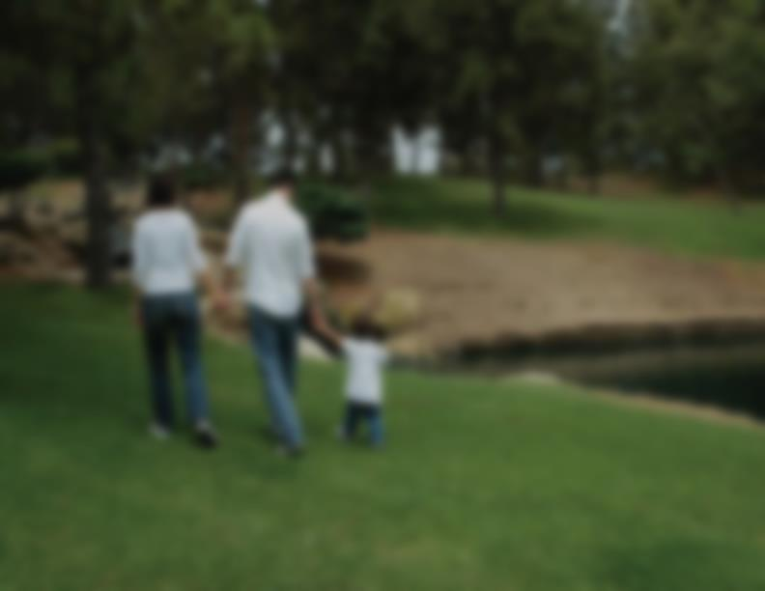

LOVE
LEARN
LISTEN
LAUGH
LEAD
LIMIT
LET LEAVE
Titus 2:4; 1 Thess. 2:11
Gen.25:27; 1 Tim. 3:4
Lk. 11:11-13; Ps. 103:13
Eccl. 3:4; Prov. 15:20; 23:24; Lk. 15:23
1 Thess. 2:10; Prov. 22:6; Is. 38:19; Eph. 6:4
1 Sam. 3:13; Prov. 29:15
Prov. 4:11, 12; Lk. 15:12

Slide 8
ISCIPLINE
D
prompt
  “Because the sentence against an evil work is not executed speedily, therefore the heart of the sons of men is fully set in them to do evil” (Eccl. 8:11)

Slide 9
ISCIPLINE
D
use of a rod
  “He who spares his rod hates his son, but he who loves him disciplines him promptly” (Prov. 13:24)

Slide 10
ISCIPLINE
D
not to kill but to correct
  “Do not withhold correction from a child, for if you beat him with a rod, he will not die” (Prov. 23:13)

Slide 11
ISCIPLINE
D
recognize there is only a window of time that is given to chasten with hope
  “Chasten thy son while there is hope, and let not thy soul spare for his crying” (Prov. 19:18)
do not apologize for appropriate discipline

Slide 12
CONCERN FOR CHILD RAISING?
with society decaying and the expansion of evil; should young married people think twice before having children?
is it right to bring children up in such a corrupt world?

Slide 13
CONCERN FOR RAISING CHILDREN IN TODAY’S WORLD?
History’s lessons:
when pharaoh desired to throw the Hebrew male babies into the Nile…
when young people were taken to Babylon to serve foreign gods…
when Herod was slaughtering male babies two years and younger…

Slide 14
Our Society
covers the altars of “selfishness,” “choice,” and “convenience” with the blood of the unborn & the innocent
perhaps God will raise up children to turn back the push for wickedness
It all begins in the home!

