Slide 2
GENESIS
Every NT Writer References Genesis
Nearly Every NT Book References Genesis
Over 100 passages in NT Reference Genesis
“If the foundations are destroyed, What can the righteous do?”
(Psalm 11:3)

Slide 3
Notes:
Consider the subject of modesty and submission (1 Tim. 2:9-12). Is modesty only a New Testament doctrine? Is a woman’s place of submission only a New Testament doctrine? If one was immodest before the New Testament was written, then one was still immodest. To be clothed was a Genesis doctrine which is also held true in the New Testament (cf. Gen. 3:21). Submission and headship were Genesis doctrines (Gen. 3:16). This rule was not placed over the woman only because she was deceived, but because of the order and purpose of her creation (1 Tim. 2:13; Gen. 2:18; 1 Cor. 11:3, 7-9).

Slide 4
Lessons From The Very First Verse!

Slide 5
“In the Beginning”
Time
Time as we know it had a beginning (Titus 1:2)
One of the dimensions of our universe
May only move forward in but identified in three ways:
Past (remember)
Present (experience, live in)
Future (anticipate, fear, hope)
Notes:
Faith and hope are connected to time. We learn from the past. We live by faith (present) and we move by hope (anticipation of future). Hope is forward looking faith (Heb. 11:1; Rom. 8:24, 25). It is not that we live in the future, but rather that we through faith anticipate a certain future whereby we move with hope.

Slide 6
“God”
NOT “in the beginning God was created”
God existed before the beginning (time)
“God’ (Heb. Elohim) teaches a plurality of persons in God
The Triune God
John 17:5; 20:17; Heb. 1:8, 9; Matt. 3:17; Heb. 1:1, 2; Jn. 5:23; Gen. 1:2; Acts 5:3, 4
Father
Son
Holy Spirit

Slide 7
“Created”
Tells of the original energy source for the creation—the infinite power of God!
Hebrew “bara” found three times (Gen. 1:1, 21, 27)
Signifies the creation of something which previously did not exist
Material substance (1:1)
Living substance (1:21)
Imperishable substance (1:27)
Notes:
Not a random act of chance. A personally purposed work

Slide 8
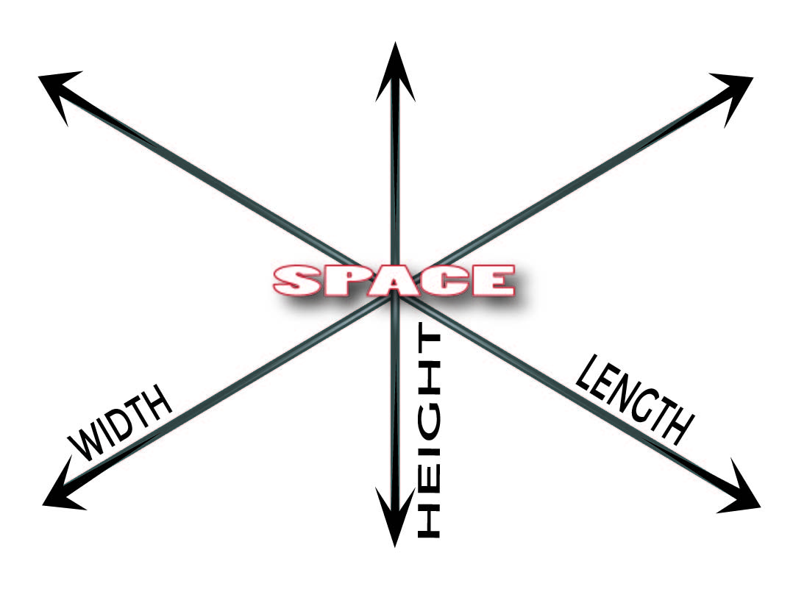
“The Heavens”
Space
Not nothingness
One of the dimensions of our universe
Observed in three dimensions
Idea of stretching out the heavens (Is. 40:22)
Notes:
We would measure the space of a room by such. Even our place one earth is measured by longitude, latitude, and elevation. Where in time we can only move forward, in space we can move up/down, side to side, forward and backward. Space is in three dimensions and yet one which may remind us of the three persons who make up God and yet He is also one.

Slide 9
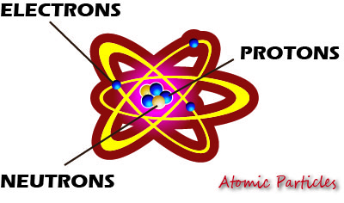
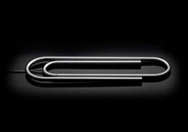
“And The Earth”
Matter
The way the universe functions may serve as a signature from the Creator
Hebrews 1:3
Romans 1:18-20
How Much energy would be released if every atom were split?
Notes:
Matter is made up of atoms which also has the three in one signature of electrons, protons and neutrons. Only hydrogen is the exception with only one electron and one proton.
Notice the word “power” in both these verses. The etymology of our word “dynamite” originates from this word. He upholds all things by the word of His power. Paul tells us that even the attributes of God’s eternal power and Godhead are seen in the things that are made. In looking at the atom which all matter is composed of, there is not only the signature of the triune God, but a pointer to His everlasting power.
Here are some fun fact that I saw from a PBS.org (The Power of Tiny Things; http://www.pbs.org/wgbh/nova/einstein/tiny-answers.html). This article noted that despite the fact that there is no way to convert a .03 ounce paperclip to energy as such would require temperatures and pressures greater than those at the core of our sun, but if you could, how much energy would that equal using Einstein’s E=mc²? Is it equal to the amount of burning 20 gallons of gasoline? Is it equal to one ton of TNT? If you could harness its power by turning every one of its atoms into pure energy it would yield about 18 kilotons of TNT. That is about the size of the atomic bomb that destroyed Hiroshima. One hundred pennies would have enough power to power the entire state of New York for two days! So, who put that power there? Where did it come from? The one who put it there has the power to dissolve it (2 Pet. 3:10). Peter was not a nuclear physicist, but was inspired to write this letter by the One who created the nucleolus and the disolving of the elements by the Creator ought to be a fearful thing to us.

Slide 10
The Answer of “God!”
Solves the riddle as to “how” and “why” the universe came into existence
Nature cries out that there was a beginning
Nature alone does not answer how the beginning began—resulting in endless speculation
Bible answers that the beginning began with an eternal God

Slide 11
What is the Relationship Between God and the Dimensions of Nature?

Slide 12
Time
As creator of time, God is over and outside of it
“Behold, God is great, and we do not know Him; Nor can the number of His years be discovered” (Job 36:26)
2 Peter 3:8
Notes:
“But, beloved, do not forget this one thing, that with the Lord one day is as a thousand years, and a thousand years as one day” (2 Pet. 3:8).

Slide 13
Space
Since God created space, He can know what happens everywhere in the universe
“‘Can anyone hide himself in secret places, So I shall not see him?’ says the LORD; ‘Do I not fill heaven and earth?’ says the LORD’” (Jer. 23:24).

Slide 14
Matter
God’s nature is superior to matter
“God is Spirit, and those who worship Him must worship in spirit and truth” (Jn. 4:24)
Seen in the prohibition to make images (Deut. 4:15ff)
Seen in the insufficiency of dwelling in a temple made with hands (Acts 17:24)

Slide 15
While the universe and everything in it needed a beginning, God does not
Asking “Who created God” would be as silly as asking “Who created the Creator?”
Only the answer of a Creator-God can solve the riddle as to “how” and “why” the universe exists
Notes:
Since He is the Creator-God, He does not need to be created. Things with a beginning had a cause. Your life and your parents’ lives and your grand-parents’ all had a beginning. You were caused to come into this world. Your birthday celebrates your time of entrance into this world by birth. However, God had no beginning and therefore He has no “birthday.” Nothing started God. He has always existed and that is what makes Him God.
We do not worship God because He needs us, but we need Him. We need to discover Him. This is why Jesus came to earth, that we might find God and turn to Him (Acts 17:25-28; Jn. 1:18; 14:16-11; 17:6; 1 Jn. 5:20; Jn. 14:21).

