Slide 2
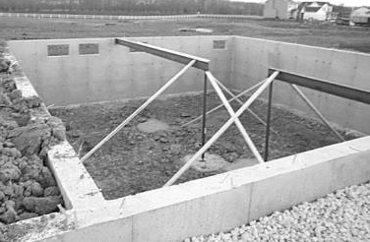
A book of beginnings
  Meaning of anything is tied to its origin
A “foundation” for the
rest of Scripture
  A basis or support
  A foundational principle
  A foundation for a house
Notes:
Foundation: a basis or support for something. A foundational principle (Prov. 18:24).
The beginning of a house is its foundation. Every house needs a good foundation and the house can only be as strong as the foundation it is built upon. The structure of the house rests upon a foundation. Jesus drew such a picture of a man who faithfully hears obeys as, “…a man building a house, who dug deep and laid the foundation on the rock. And when the flood arose, the stream beat vehemently against that house, and could not shake it, for it was founded on the rock. But he who heard and did nothing is like a man who built a house on the earth without a foundation, against which the stream beat vehemently; and immediately it fell. And the ruin of that house was great” (Lk. 6:48, 49). Without a deep and stable foundation, the house is easily destroyed by a current of water.

Slide 3
GENESIS
Every NT Writer References Genesis
Nearly Every NT Book References Genesis
Over 100 passages in NT Reference Genesis
“If the foundations are destroyed, What can the righteous do?”
(Psalm 11:3)

Slide 4
Jesus
Creation
Flood
Sodom
Apostles
Creation
Male Female
Adam Eve
Flood
Sodom
“If the foundations are destroyed, What can the righteous do?”
(Psalm 11:3)
Notes:
We would not have a clear understanding of sin without the teaching of Genesis 3-11. We should also appreciate that Jesus spoke of the creation, the first couple, the flood, and of the destruction of Sodom and Gomorrah as fact (Mk. 10:6; Matt. 24:37-39; 10:15; etc.).
Apostles: 1 Cor. 15:21, 22, 45, 47-49—creation; 1 Tim. 2:13, 14; 2 Cor. 11:3; 2 Pet. 2:5-7; 3:1ff.

Slide 5
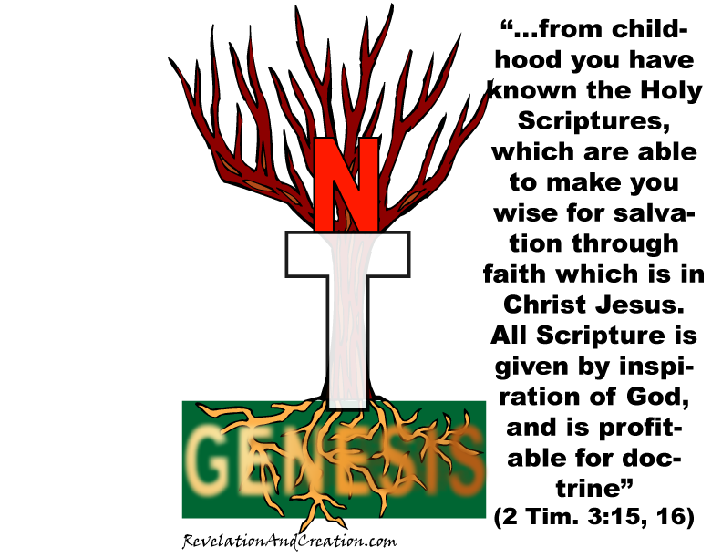
What About This?
If Corrupt?
Notes:
How strong is a plant without its roots (Mk. 4:6, 17).

Slide 6
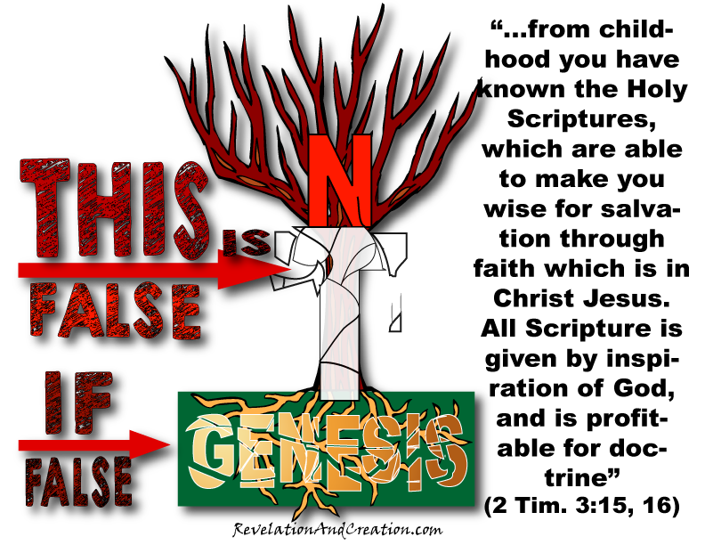
Notes:
Consider the subject of modesty and submission (1 Tim. 2:9-12). Is modesty only a New Testament doctrine? Is a woman’s place of submission only a New Testament doctrine? If one was immodest before the New Testament was written, then one was still immodest. To be clothed was a Genesis doctrine which is also held true in the New Testament (cf. Gen. 3:21). Submission and headship were Genesis doctrines (Gen. 3:16). This rule was not placed over the woman only because she was deceived, but because of the order and purpose of her creation (1 Tim. 2:13; Gen. 2:18; 1 Cor. 11:3, 7-9).

Slide 7
The Value of Genesis

Slide 8
To Understand God’s Word
2 Timothy 3:15, 16
John 5:46, 47
Jesus and Genesis (Gen. 3:15; 22:18; 49:8-12)
tied
JESUS
GENESIS

Slide 9
To Understand God’s World
SIN—THE PROBLEM
  Enmity and conflict (Gen. 3:15; Gen. 4)
  Suffering (Gen. 3:16)
  Toil/sorrow (Gen. 3:17, 18; Gen. 5:29)
  Death (Gen.3:19; 5:5ff)
  Wild and dangerous animals (Gen. 1:30; 9:2-5)
  Confusion (Gen. 11)

Slide 10
To Understand Important Doctrines
The meaning of something is tied to its origin
Genesis provides information about origins
Genesis provides meaning
  Marriage
  Clothing
  Life and Death
  Headship & Submission

Slide 11
To Understand Our Soul’s Adversary
A cunning serpent—suggestive questioning
Attacks God’s word—brings contradictions
Attacks the God’s character
Appeals to our pride
2 Corinthians 11:3
Notes:
Genesis 3:1-5

Slide 12
Lessons From The Very First Verse!

