Slide 2
Isaac & Rebekah: The Journey for the Bride of Promise

Slide 3
Sarah’s death marked thirty-seven years since Isaac was born
90 yrs. bore Isaac
127 yrs. Died
Isaac married three years later
“for in Isaac your seed shall be called” (Gen. 21:12)

Slide 4
The Oath In Finding The Bride GENESIS 24:1-9
Where not to get a wife 24:3
Where to get a wife 24:4
Do not take Isaac 24:5-8

Slide 5
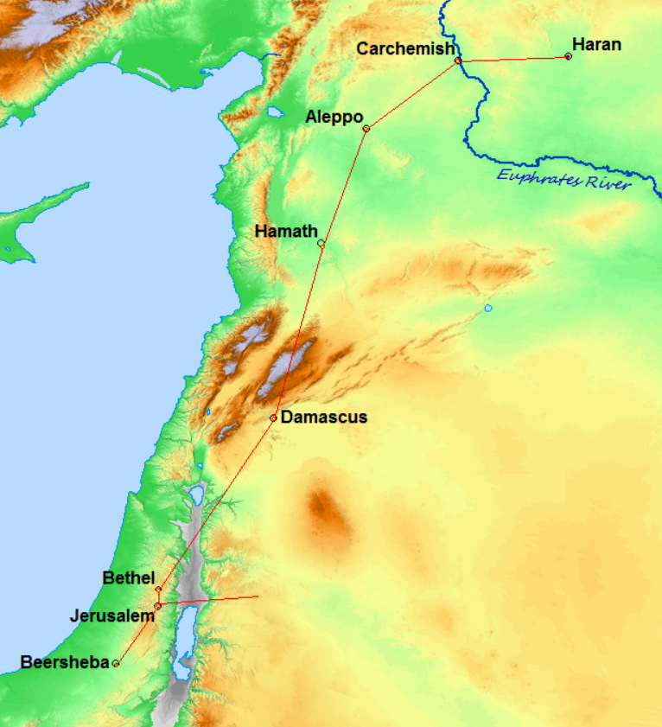
Wisdom In Finding The Bride GENESIS 24:10-14
Bring others
Choose the proper place and timing
Pray
About 550 miles

Slide 6
CHARACTERISTICS OF THE

Slide 7
Characteristics of the Bride GENESIS 24:15-28
Diligent To Obey 24:15 | Rom. 12:11
Valued Her Purity 24:16 | 2 Cor. 11:2
Respectful & Compassionate 24:17, 18 | Rom. 12:8

Slide 8
Characteristics of the Bride GENESIS 24:15-28
Courteous & Considerate 24:19 | 1 Pet. 3:8
Energetic 24:20 | Gal. 3:8; Titus 3:14
Hospitable 24:23-25 | 1 Pet. 4:9

Slide 9
19 "Do not lay up for yourselves treasures on earth, where moth and rust destroy and where thieves break in and steal;
20 "but lay up for yourselves treasures in heaven, where neither moth nor rust destroys and where thieves do not break in and steal.
21 "For where your treasure is, there your heart will be also.
Matthew 6:19-21

