Slide 1
The Journey of Faith (3)

Slide 2
2 Chronicles 20:7 | Isaiah 41:8 | James 2:23

Slide 3
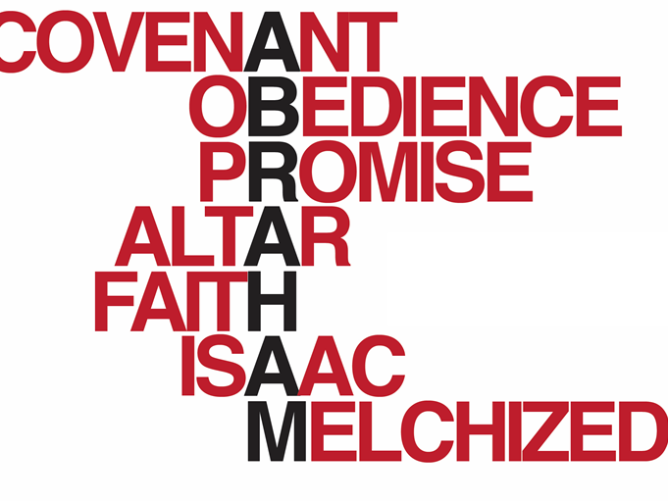
Obedient
Considerate
Courageous to save Lot
Honored the Lord
Guarded reputation
Entreated God on behalf of others

Slide 4
WHERE THE JOURNEY OF FAITH CAN TAKE ONE
The Journey of Faith takes us to the summit of fully trusting God
Mount Moriah was Abraham’s summit
Partial obedience is never obedience

Slide 5
ROMANS 4:19-22
About 100 years old
Not being weak in faith
Did not waver
Strengthened in faith
Fully convinced

Slide 6
BEFORE GENESIS 22
BELIEVED GOD; BUT…
Took part in a carnal plan (Gen. 16)
Laughed (Gen. 17:17)
Emphasized Ishmael (Gen. 17:18)
Continued to struggle with fear (Gen. 20)

Slide 7
GENESIS 21:1, 2
1 And the LORD visited Sarah as He had said, and the LORD did for Sarah as He had spoken.
2 For Sarah conceived and bore Abraham a son in his old age, at the set time of which God had spoken to him.

Slide 8
IN GENESIS 22
ROSE EARLY
SAW HIS SON RETURNING WITH HIM
KNEW GOD WOULD PROVIDE
NO IMPROVISING

Slide 9
ROMANS 4:23, 24 “Now it was not written for his sake alone that it was imputed to him, but also for us. It shall be imputed to us who believe in Him who raised up Jesus our Lord from the dead.”
WHAT SAVING FAITH LOOKS LIKE

Slide 10
JAMES 2:20 “But do you want to know, O foolish man, that faith without works is dead?”
SAVING FAITH

Slide 11
JAMES 2:21, 22 “Was not Abraham our father justified by works when he offered Isaac his son on the altar? Do you see that faith was working together with his works, and by works faith was made perfect?
SAVING FAITH

Slide 12
JAMES 2:23 “And the Scripture was fulfilled which says, ‘Abraham believed God, and it was accounted to him for righteousness.’ And he was called the friend of God.”
SAVING FAITH

Slide 13
Genesis 15:6
Genesis 22:12

Slide 14
JAMES 2:24 “You see then that a man is justified by works, and not by faith only.”
SAVING FAITH

Slide 15
JOHN 8:39 “They answered and said to Him, ‘Abraham is our father.’ Jesus said to them, ‘If you were Abraham’s children, you would do the works of Abraham.’”
SAVING FAITH

Slide 16
“… It shall be imputed to us who believe in Him who raised up Jesus our Lord from the dead, who was delivered up because of our offenses, and was raised because of our justification.”
ROMANS 4:24, 25

Slide 17
Will You Believe In His Death & Resurrection Through Obeying The Command To Be Baptized?

