Slide 1
Abraham & Lot
THE JOURNEY OF FAITH (2)

Slide 2
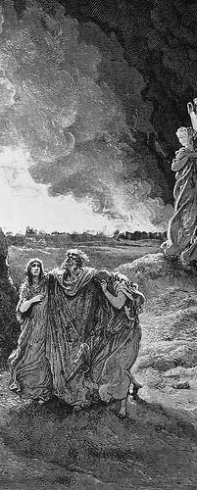
Lot’s Gain and Loss

Slide 3
Ten Relevant Facts About Lot
Had godly influences in Abraham and Sarah
Chose to journey to the Promised Land
Was blessed by God
Made a terrible decision
Continued in that decision

Slide 4
Ten Relevant Facts About Lot
Remained hospitable to strangers in a godless society
Was tormented and oppressed by his countrymen
Scarcely escaped the destruction of the wicked
Lost “A LOT!”
Reputation faded into darkness

Slide 5
Romans 15:4
“For whatever things were written before were written for our learning, that we through the patience and comfort of the Scriptures might have hope.”

Slide 6
Valuable Lessons From Lot
The infectious influence of evil people
Toxic relationships can corrupt us (1 Cor. 15:33; 2 Cor. 6:14)
The danger of alcohol
Proverbs 20:1, “Wine is a mocker, Strong drink is a brawler, And whoever is led astray by it is not wise”

Slide 7
Valuable Lessons From Lot
The danger of pride and worldly persistence
Two choices exist when we make a bad decision: desist or persist!
Proverbs 11:2, “When pride comes, then comes shame; But with the humble is wisdom.”
Proverbs 29:23, “A man’s pride will bring him low, But the humble in spirit will retain honor.”

Slide 8
Valuable Lessons From Lot
Do not linger when grace calls you forward
Genesis 19:15-26

Slide 9
Luke 17:28-32

