Slide 1
The Rainbow COVENANT
Genesis 9:8-17

Slide 2
What Does The SIGN of the COVENANT Tells Us?
"I set My rainbow in the cloud, and it shall be for the SIGN of the covenant between Me and the earth.”
--Genesis 9:13

Slide 3
“COVENANT”
Found seven times in the text
IMPLICATIONS ABOUT THE SIGNMAKER:
God is a Covenant-Making God
God is “Longsuffering”
God is “Faithful”

Slide 4
GOD IS FAITHFUL!
2 THESSALONIANS 1:6-12
REST
RETRIBUTION
faithful
disobedient

Slide 5
“COVENANT”
Found seven times in the text
IMPLICATIONS OF THE SIGNMAKER:
God is a Covenant-Making God
God is “Longsuffering”
God is “Faithful”
God is a “Forbearing” Warrior

Slide 6
“Rainbow” → “BOW”
A very effective weapon of war
To dash young men (Is. 13:18)
“Song of the Bow” in memory of Saul and Jonathan (2 Sam. 1:17, 18)
literally
Notes:
Read 9:12-17
Song of the Bow—Saul severely wounded by the bow (1 Sam. 31:3).

Slide 7
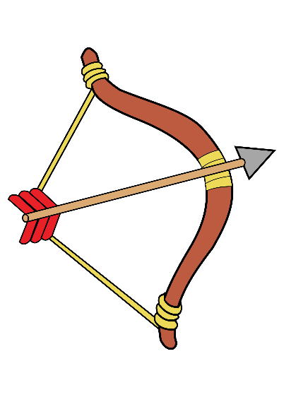
The Sign of The Rainbow
“A MAN OF WAR”
“The LORD is a man of war; The LORD is His name” (Exod. 15:3)
Described as a swordsman and an archer
Ps. 7:11-13; 2 Sam. 22:15; Ps. 18:14

Slide 8
“I do set my bow in the cloud, and it shall be for a token of a covenant between me and the earth” (Gen. 9:13, KJV)
SET IN THE CLOUD
The Significance of the Sign

Slide 9
When The Rainbow Ends!
2 PETER 3
Heaven
Hell
MERCY
JUDGEMENT DAY IS COMING!
THE
FLOOD

Slide 10
When The Rainbow Ends!
2 PETER 3
Heaven
Hell
MERCY
Judgment
Day
REPENTANCE
THE
FLOOD
2 PET. 3:9
U TURNS

Slide 11
We Are Living In The Age Of Grace
THE AGE OF FORBEARANCE
THE FLOOD
THE FIRE
REPENTANCE
Genesis 9
2 Peter 3

Slide 12
The Rainbow COVENANT
Genesis 9:8-17
Notes:
SAVING GRACE TODAY
Through hearing the message
Matt. 11:15; John 8:43
Through believing the message
John 8:24, 46
Through repenting of sin
Luke 15:10
Through confessing Christ as Lord
Matthew 10:32
Through being immersed in Christ
Mark 16:16

Slide 13
Saving Grace TODAY
“He who believes and is baptized will be saved; but he who does not believe will be condemned”
MARK 16:16
Notes:
SAVING GRACE TODAY
Through hearing the message
Matt. 11:15; John 8:43
Through believing the message
John 8:24, 46
Through repenting of sin
Luke 15:10
Through confessing Christ as Lord
Matthew 10:32
Through being immersed in Christ
Mark 16:16

