Slide 1
Noah’s
GENESIS 8
Notes:
Permission is not granted to publish these charts on any website.
All the land dwelling creatures that are alive today have their roots in that ark. There was in the past a massive die-off as is seen in the fossil recorded and as described by the Bible. This event is what Noah survived and through his work and the grace of God a repopulation of life occurred.

Slide 2
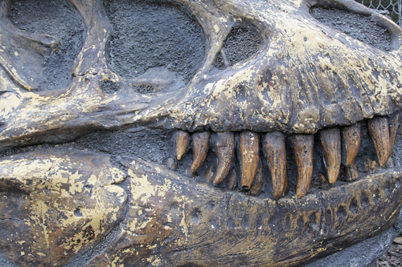
⇜Our Views ⇝
1. God’s Unchanging Word
2. Man’s Wisdom
CREATION: God created the heavens, earth, and all things (Gen. 1, 2)
MASSIVE DIE-OFF: global flood (Gen. 6-9)
CREATION: Big bang out of nothing; evolution of life from non-living material
MASSIVE DIE-OFF: extraterrestrial impact, volcanism, toxic water
3. Mixed & Mashed
Notes:
The massive fossil graveyard encased in rock layers in the earth’s crust cries out death and a great dying of many life forms. As scientists have sought purely naturalistic explanations of the origin of creation (a big bang which supposedly started out in absolute nothingness and the evolution of life which was born out of nonliving matter throughout millions of years), so they have postulated many different causes for The Great Dying, a mass extinction which the fossil record cries out.
As to beginnings we can build our understanding on the ever changing opinions of men which are haled today as immovable fact only to be discarded in tomorrow’s rubbish or we can build our thinking on God’s unchanging word. The doctrine that God created all things in six days never needs to be revised or rethought (Gen. 1-2; Exod. 20:11). Likewise, we can believe man’s ever changing assumptions regarding a past mass die-off or we can stand upon the unchanging word of God as it speaks of an unparalleled world-wide catastrophic flood that devastated and altered the globe, wreaked havoc on marine life, and ended all life that moved upon the earth with the exception of the species preserved in the ark as spoken of in Genesis 6-9.

Slide 4
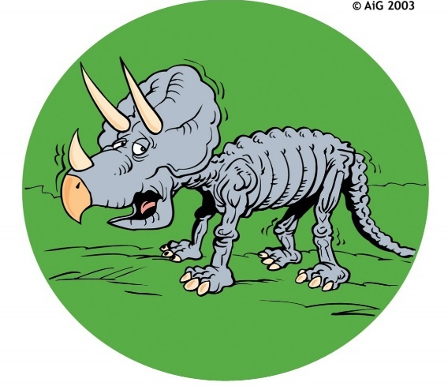
Man’s Speculative Ideas Of Extinction
ASTEROID?
STARVATION?
Notes:
These speculations would include a hypothetical impact of a huge asteroid that supposedly collided with the earth. Others surmise massive volcanic activity where enormous amounts of ash spewed into the atmosphere that had a catastrophic effect on life. Still others propose the possible spread of toxic, oxygen depleted, water that produced massive land and marine die offs over thousands or perhaps millions of years.

Slide 5
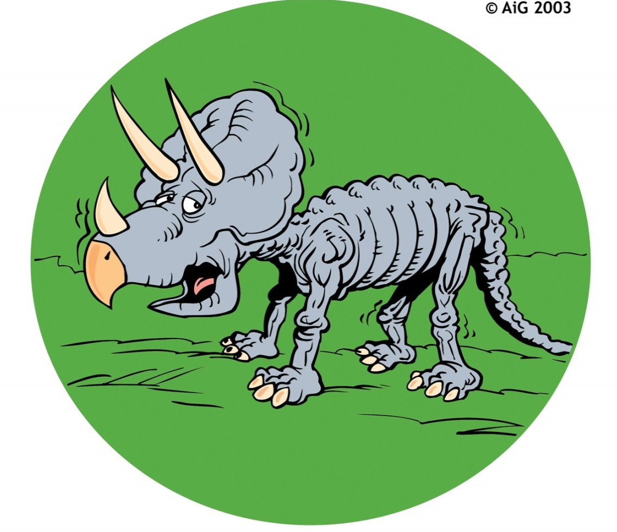
Man’s Speculative Ideas Of Extinction
ASTEROID?
STARVATION?

Slide 6
Man’s Speculative Ideas Of Extinction
WHY NOT GLUTTONY?

Slide 7
GENESIS 7:23, 24
23 So He destroyed all living things which were on the face of the ground: both man and cattle, creeping thing and bird of the air. They were destroyed from the earth. Only Noah and those who were with him in the ark remained alive.
24 And the waters prevailed on the earth one hundred and fifty days.
Notes:
There was in the past a massive die-off as is seen in the fossil recorded and as described by the Bible. This event is what Noah survived and through his work and the grace of God a repopulation of life occurred.

Slide 8
GOD REMEMBERED
GENESIS 8:1-5

Slide 9
WRATH & MERCY
GENESIS 7
GENESIS 8
WRATH
GRACE
Notes:
Where Genesis 7 is about the judgment and wrath of God on a world of sinners, Genesis 8 manifests the grace of God on Noah and his family. Noah found grace in the eyes of the Lord (Gen. 6:8). But grace is reached through obedience to the word of the Lord. Noah had done all that the Lord had commanded him (Gen. 6:22).

Slide 10
God Does Not Forget His People
ISRAELITES IN EGYPT
Ex. 2:23-25; 9:1-7, 22-26; 11:7

Slide 11
Isaiah 49:14-16
¹⁴ But Zion said, "The LORD has forsaken me, And my Lord has forgotten me."
¹⁵ "Can a woman forget her nursing child, And not have compassion on the son of her womb? Surely they may forget, Yet I will not forget you.
¹⁶ See, I have inscribed you on the palms of My hands; Your walls are continually before Me.
Notes:
While Noah was in the ark the days turned to weeks and the weeks to months, but God did not forget him. We can have the same confidence in God today that if we obey God, he will never forget or forsake us. “For God is not unjust to forget your work and labor of love which you have shown toward His name, in that you have ministered to the saints, and do minister” (Heb. 6:10). “Let your conduct be without covetousness; be content with such things as you have. For He Himself has said, ‘I will never leave you nor forsake you’” (Heb. 13:5).

Slide 12
WHEN GOD REMEMBERED NOAH
Made a wind
Stopped fountains of deep
Closed windows of heaven
Lowered the valleys and pushed up the mountains
Notes:
1. He made a wind to pass over the earth. This wind would have aided in evaporation and to help dry the ground.
2. He made the fountains of the deep stop. He closed the waters from spewing out from under the earth.
3. He closed the windows of heaven and the rain was restrained.
4. From Psalm 104:5-9 we also learn that God actually caused the mountains to rise higher and the valleys or ocean floors to sink lower. This would have caused the world to have deeper oceans and taller mountains than it previously had before the flood. Eventually the ark came to rest on the mountains of Ararat (Gen. 8:5). We do not know which mountain this was. Many have searched for the remains of the ark which likely have long ago been lost. We do not need to find wood from the ark to believe it existed any more than we need to find a blood stained cross from the first century to believe Jesus was crucified. It is enough that the Bible says it. The Bible is are standard of authority and our source for faith.

Slide 13
Noah Waited
GENESIS 8:6-19
Notes:
While there are many things we could talk about from this text, Noah’s patient waiting on the Lord is what jumps out from the text.

Slide 14
THE PATIENT WAITING
Ark Rests
Mount. Tops
Opens Window
Waits 7 Days
Waits 7 Days
7th mo., 17th d.
10th mo., 1st d.
11th mo., 10th d.
11th mo., 17th d.
11th mo., 24th d.
Removes Cover
1st mo., 1st d.
Exits Ark
2nd mo., 27th d.
Gen. 8:4
Gen. 8:5
Gen. 8:6
Gen. 8:10
Gen. 8:12
Gen. 8:13
Gen. 8:14-16
3 mo., 23 days
5 ½ mo.
7 mo., 10 days
Notes:
1. The ark comes to a halt and rests on a mountain in Ararat in the seventeenth day of the seventh month (Gen. 8:4). Note: Appreciate the Bible uses months and days to show this is the language of real history. While the ark had come to rest, it is still in deep water.
2. About 2 ½ months later on the first day of the tenth month the tops of the mountains become visible (8:5). What is Noah doing? He is still waiting.
3. Forty more days pass (8:6). This would place us in the eleventh month, tenth day, nearly four months since the ark came to rest. Noah is still waiting on the Lord. Everyone is still in the ark. We don’t hear of any protests either of Noah’s family or the animals. All are simply waiting in the ark. The waters are gradually subsiding outside the ark. Noah doesn’t kick the door down and sprint outside but is patiently waiting. He opens the window of the ark and experiments with two distinct kinds of birds: a raven and a dove. The raven is an unclean bird (Lev. 11:15). He leaves and evidently does not come back inside the ark but is content to go to and fro. A dove on the other hand, is a clean bird and was used for sacrifice (Lev. 1:14). The dove Noah sent out was more selective as to where she would place her foot. She returned into the ark to him finding no such suitable place.
4. Next we see our key word “waited” (8:10). He waited another seven days to send her out again. This seven days period is a literal as the seven day creation period. What one is the other is. This time the dove brings a freshly plucked olive leaf which gave Noah the understanding that the water had receded.
5. We see our word again (8:12). This time the dove did not return.
6. He continues to wait and now we reach the first month, first day of the month (8:13). Noah has been in the ark about 5 ½ months since the ark rested. What does Noah do? He continues to wait almost another 2 months until the 27th day of the second month (8:14). Noah waited seven months and ten days inside the ark after it came to a standstill. Why? It is simple, God had told him when to enter the ark (Gen. 7:1). Noah was not going to exit until the Lord permitted him. Noah was a very patient man. What would you have done if you were Noah? What if you were his wife? What if you were his son or daughter in law? Notice the word “then” in 8:15. Then God said “Go out of the ark.”

