Slide 1
GENESIS 5
The Epitaph of SIN

Slide 2
GENESIS 3
  Sin Brings Separation From God
GENESIS 4
  Sin Brings Animosity Between Brothers
GENESIS 5
  Sin Brings Death

Slide 3
Genesis Five: The Genealogy
All Scripture is given by inspiration of God, and is profitable for doctrine, for reproof, for correction, for instruction in righteousness” (2 Tim. 3:16)
Real history
Real people
  “…and he died.”
Record of the narrowing line of the Seed promise

Slide 4
God Keeps His Word
Genesis 2:16, 17:
“And the LORD God commanded the man, saying, ‘Of every tree of the garden you may freely eat; but of the tree of the knowledge of good and evil you shall not eat, for in the day that you eat of it you shall surely die.’”
Spiritual death began that day
The journey to physical death began that day
  “in dying you shall die.”
The seed promise narrowed (Gen. 3:15)
  From Seth to Noah (cf. Gen. 4:25)

Slide 5
Two Chapters Connected
Chapter 4
Chapter 5
Cain’s line
Worldly success
Walking away from God
Seth’s line
Spiritual Success
Walking with God

Slide 6
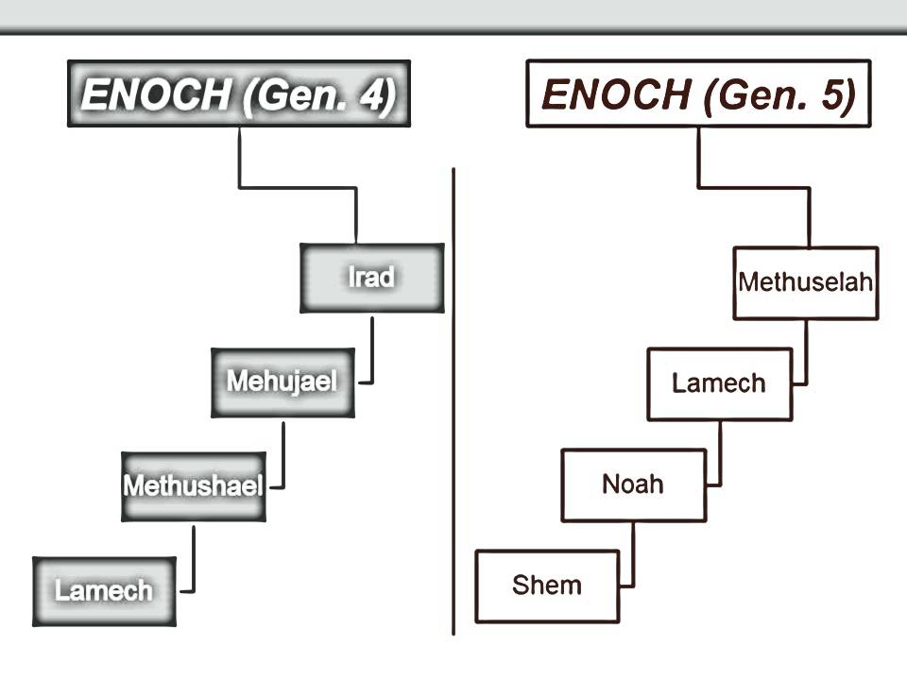
Compared & Contrasted
contemporaries
Polygamist
Murderer
Proud
Tramples God’s word

Slide 7
Observations: Walking Away From God
MAN CAN WALK AWAY
  John 6:66; 1 Timothy 5:15; 2 Tim. 1:15; 2:18; 4:10
FAITHFULNESS CAN BE SHORT LIVED
  Hosea 6:4, “O Ephraim, what shall I do to you? O Judah, what shall I do to you? For your faithfulness is like a morning cloud, And like the early dew it goes away.”

Slide 8
Observations: Walking Away From God
ONCE SAVED ≠ ALWAYS SAVED
  Heb. 3:12, “Beware, brethren, lest there be in any of you an evil heart of unbelief in departing from the living God”
  People once believed (Heb. 11:29)
  Later became unbelieving (Heb. 3:14-19)

Slide 9

Observations: Walking Away From God
GOD HAS NO DELIGHT IN THOSE WHO WALK AWAY
  Hebrews 10:38, 39
  Contrasted
    “For by it the elders obtained a good testimony” (Heb. 11:2)

Slide 10
Observations: Walking Away From God
THE EFFECTS OF DEPARTURE
Leads to the destiny of the dead
  Proverbs 21:16; 1 John 2:19
Leads others away from the truth
  Luke 11:45-54
Leads descendants to doom
  Amos 2:4; Jeremiah 9:13-15; Luke 6:39

