Slide 1
Corruption of Brotherly Love
Genesis 4:8-15

Slide 2
The Way Of Cain
The characteristics that break down brotherly love

Slide 3
Breaks Down Brotherly Love
Jude 1:8-13
  Is a danger among disciples of Christ
  Has characteristics of pride, carnality, fruitlessness, slander, and uncontrolled anger
  Where sin is the master (cf. Gen. 4:7)

Slide 4
The Way Of Cain
The characteristics that break down brotherly love
The acts that bury brotherly love under self-will

Slide 5
The Many Hindrances To Brotherly Love
Propping up will-worship (Gen. 4:3–5ª)
Anger against the truth (Gen. 4:5^{b}, 6)
An unwillingness to rule over the tendency to sin (Gen. 4:7)
Murder (Gen. 4:8)
Hatred (1 Jn. 3:10–15)
Deceit/Lies (Gen. 4:9)
Apathy and indifference (Gen. 4:9)

Slide 6
Am I My Brother’s Keeper?
Who or what is a “keeper”?
  To guard, protect, watch out for
    Nehemiah 3:29?
    Esther 2:21?

Slide 7
How Should I Keep My Brother?
Watch out for those who are falling
(Gal. 6:1)
  1 Thessalonians 5:14, 15:
  “Now we exhort you, brethren, warn those who are unruly, comfort the fainthearted, uphold the weak, be patient with all. See that no one renders evil for evil to anyone, but always pursue what is good both for yourselves and for all.”

Slide 8
How Should I Keep My Brother?
Watch out for those who are falling
(Gal. 6:1)
Help bear another’s burden (Gal. 6:2)
Bear my own load (Gal. 6:3-5)
Share in all good things with him who teaches (Gal. 6:6)
Do good to all (Gal. 6:9, 10)
  Do not become a stumbling to others

Slide 9
The Way Of Cain
The characteristics that break down brotherly love
The acts that bury brotherly love under self-will
The transparency before God and others

Slide 10
Transparency of Sin On The Way of Cain
Genesis 4:10-15
Those who trod on it are self-deceived
Some men’s sins will go undetected by man—all sin will be exposed by God
  1 Timothy 5:24
  Numbers 32:23; Ecclesiastes 12:14
  Proverbs 26:24-26

Slide 11
Transparency of Sin On The Way of Cain
The lack of repentance is evident
  Hebrews 12:17; 1 Timothy. 5:25
  No remorse; no repentance
The presence of self-pity
  The offender becomes the victim of unfair punishment (Gen. 4:13)

Slide 12
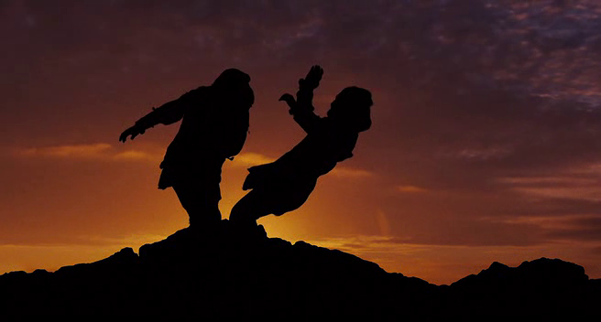
TEN LESSONS FROM KILLING ABEL
Worship Really Does Matter
Each life is governed by God’s will or self-will
Evil has a very real presence in our world
The righteous will suffer for the cause of truth
The truth will make some people very angry

Slide 13
TEN LESSONS FROM KILLING ABEL
Sin is a consensual choice, not an unavoidable cliff
Sin can make brothers hate brothers
Someone's sin can affect another who is innocent
God knows when the innocent suffer
The lives of the dead can speak great lessons for us to hear

Slide 14
Hebrews 12:14, 15
14 Pursue peace with all people, and holiness, without which no one will see the Lord:
15 looking carefully lest anyone fall short of the grace of God; lest any root of bitterness springing up cause trouble, and by this many become defiled

