Slide 1
Sin and its Consequences
Genesis 3:7-24
Part 4

Slide 2
Previously:
Sin brings shame
Sin brings separation
Sin brings the tendency to justify myself

Slide 3
4. Sin Brings Curses
GENESIS 3:14-19
KEY WORD: “CURSE”
The Serpent (3:14, 15)

Slide 4
“ENMITY”
Between You And The Woman
Between Your Seed And Her Seed

Slide 5
4. Sin Brings Curses
GENESIS 3:14-19
KEY WORD: “CURSE”
The Serpent (3:14, 15)
The Woman (3:16)
The Man (3:17-19)
LESSON: There is never an excuse to justify sin (Rom. 1:20, 21)

Slide 6
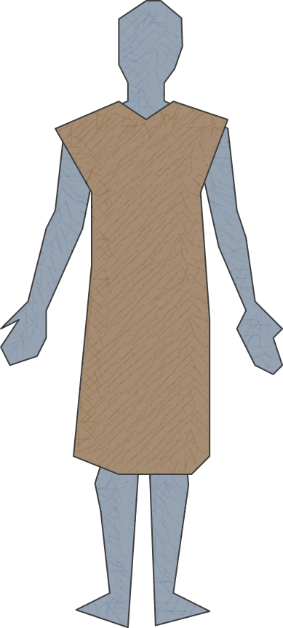
5. Sin Requires A Covering
GENESIS 3:20, 21
MADE TUNICS OF SKIN
“Made” (make, 2:18)
Why did God make TUNICS of SKIN for Adam and Eve?
To solve the issue with nakedness (3:10)
The shadow of redemption
Hebrews 9:22, “…without the shedding of blood there is no remission.”

Slide 7
Facts About Clothing
One can wear something and yet be naked (Gen. 3:7, 10)
Clothing communicates something
That Jacob loved Joseph more than the others (Gen. 37:3, 4)
That some were virgins (2 Sam. 13:18, 19)
That some were harlots (Prov. 7:10)
Sensibility (Mk. 5:15)
There is a standard for what is modest (Rom. 12:1, 2)

Slide 8
Body Presentation
“In like manner also, that the women adorn themselves in modest apparel, with propriety and moderation” (1 Tim. 2:9)
Definitions:
Modest– well-arranged; seemly (Thayer)
Propriety– a sense of shame, bashfulness, regard for others (Thayer)
Moderation– reasonableness, rationality, mental soundness, good judgment, moderation, self – control (Arndt and Gingrich)
If the heart is right, the hemline will be right (1 Pet. 3:3-4)

Slide 9
The Tunic & The Body
“…corresponding most nearly to our long shirt, reaching below the knee always, and, in case it was designed for dress occasions, reaching almost to the ground” (I.S.B.E., II:877).

Slide 10
Covering Nakedness
“And you shall make for them linen trousers to cover their nakedness; they shall reach from the waist to the thighs” (Ex. 28:42)
The thighs were to be covered (Is. 47:2, 3)
“From A to Z” includes “Z”
1 Timothy 2:9, 10

Slide 11
Why Clothing Matters
Because God chose to clothe our first parents
Because nakedness is associated with shame
Because clothing reflects the heart
Because we are to make no provisions for the flesh
Because the body is the temple of God
Notes:
Romans 13:13, 14.

Slide 12
Both Physical & Spiritual Nakedness Matter!
Faithful obedience is required for both to covered!
Modest clothing → PHYSICAL
1 Timothy 2:9, 10
The Lamb of God → SPIRITUAL
John 1:29; Galatians 3:26, 27

