Slide 1
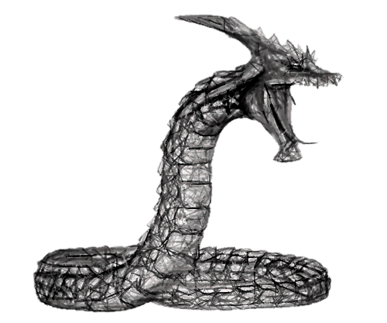
Part 4

Slide 2
The serpent’s
identity
craftiness
questioning
contradicting

Slide 3
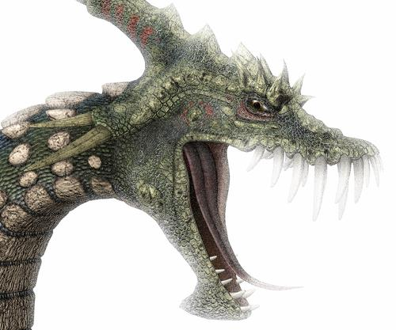
redefines GOD
GENESIS 3:5
“For God knows that in the day you eat of it your eyes will be opened, and you will be like God, knowing good and evil.”

Slide 4
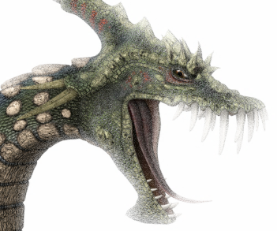
THE GRASS IS ALWAYS GREENER on the Other Side of the Fence!
Why The Grass Might “Appear” Greener On The Other Side:
Artificial Turf
Use
Neglect
Waning Commitment
Discontentment
Covetousness
A FENCE
John 15:4ff
Deuteronomy 19:14

Slide 5
God’s Proven Character
Gave His Son to provide us eternal life
In contrast to believing the devil’s tale → DEATH
Abundant life (Jn. 10:10-13)
Not through disobeying God
Not through the accumulation of wealth
But through loving and obeying Christ

Slide 6
John 14:6 —Jesus, The Way
Life more abundant
John 10:10-13
Is in His Son
1 Jn. 5:11, 12
Through Gospel
2 Tim. 1:10
Hear & Believe
Jn. 5:24; 11:25
Repent
Acts 11:18
Buried and Raised in Baptism
Jn. 11:26
Col. 2:12, 13; 3:1-4
"I am the door. If anyone enters by Me, he will be saved…”
JOHN 10:9
ENTER
FOR
LIFE

Slide 7
BUYING Into The DEVIL’S LIE
“I am too young to get religious Today.”
Translation?
I have too many sinful and fun things to pursue!
God is too restrictive!
When I have burned my life out and broken it into a million pieces, then…
Romans 6:20, 21

Slide 8
John 8:44
“You are of your father the devil, and the desires of your father you want to do. He was a murderer from the beginning, and does not stand in the truth, because there is no truth in him. When he speaks a lie, he speaks from his own resources, for he is a liar and the father of it.”

