Slide 1
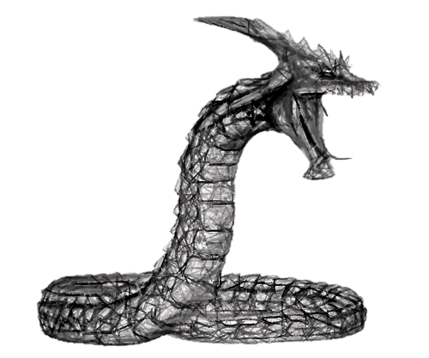
Part 3 continued

Slide 2
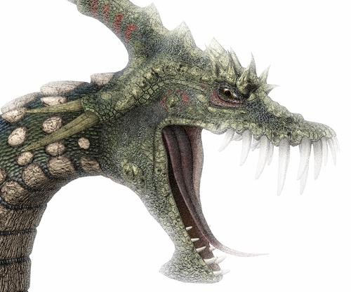
contradicts GOD’S
WORD
GENESIS 3:2-4
“And the woman said to the serpent, ‘We may eat the fruit of the trees of the garden; but of the fruit of the tree which is in the midst of the garden, God has said, “You shall not eat it, nor shall you touch it, lest you die.”’ Then the serpent said to the woman, ‘You will not surely die.’”

Slide 3


“NOTS” in the Devil’s
ale
You will
NOT surely die!”
God is not severe!
There is not a hell!

Slide 4
“NOTS” in the Devil’s
ale
You will
NOT surely die!”
Your heart is not wrong—follow it!
A man is not justified by works!
Misuse of Romans 4:1-4 & Ephesians 2:8, 9

Slide 5
“Not Of Works”
WHAT WORKS?
Works of the Devil (1Jn.3:8)?
Works of darkness (Eph.5:11)?
Works of the flesh (Gal.5:19)?
Works of the Law of Moses (Gal.2:16)?
Works of God (Jn.6:28-29)?
  Work of faith (1 Thess. 1:3; 2 Thess. 1:11)

Slide 6
ROMANS 3 & 4
CONTEXT
DISCUSSING “WORKS” OF THE “LAW”
“therefore we conclude that a man is justified by faith apart from the deeds of the law. Or is He the God of the Jews only?” (Rom. 3:28, 29)
DEEDS OF WHAT LAW?
OF THE JEWS!

Slide 7
ROMANS 3 & 4
CONTEXT
Abraham had “steps” of faith, NOT FAITH ALONE!
“and the father of circumcision to those who not only are of the circumcision, but who also walk in the STEPS of the faith which our father Abraham had while still uncircumcised” (4:12)

Slide 8
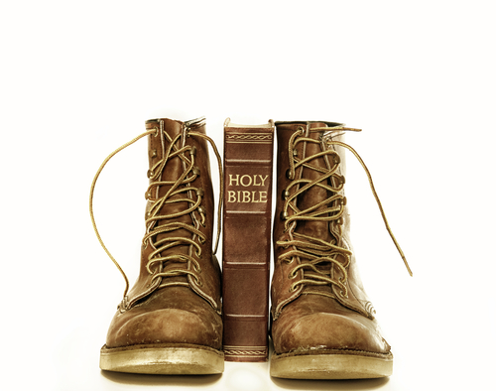
“STEPS OF FAITH” INVOLVED
OBEDIENCE!
“BY FAITH ABRAHAM
OBEYED
WHEN HE WAS CALLED TO GO OUT TO THE PLACE WHICH HE WOULD RECEIVE AS AN INHERITANCE. AND HE WENT OUT, NOT KNOWING WHERE HE WAS GOING.”
HEBREWS 11:8

Slide 9
“STEPS OF FAITH” INVOLVED
ENDURANCE!
“And so, after he had patiently ENDURED,
he obtained the promise.”
HEBREWS 6:15

Slide 10
“STEPS OF FAITH” INVOLVED
WORKS!
“IF YOU WERE ABRAHAM’S CHILDREN, YOU WOULD DO THE
WORKS
OF ABRAHAM.”
JOHN 8:39

Slide 11
“STEPS OF FAITH” INVOLVED
WORKS OF FAITH!
“DO YOU SEE THAT FAITH WAS WORKING TOGETHER WITH HIS WORKS, AND BY WORKS FAITH WAS MADE PERFECT? AND THE SCRIPTURE WAS FULFILLED WHICH SAYS, ‘ABRAHAM BELIEVED GOD, AND IT WAS ACCOUNTED TO HIM FOR RIGHTEOUSNESS.’ AND HE WAS CALLED THE FRIEND OF GOD.”
JAMES 2:22, 23

Slide 12
AN APPLICATION OF ABRAHAM’S EXAMPLE
“
YOU SEE THEN THAT A MAN IS JUSTIFIED BY
WORKS,
AND NOT BY
FAITH ONLY.
JAMES 2:24

Slide 13
CONTRADICT OR COMPLIMENT?
“For if Abraham was justified by works, he has something to boast about, but not before God.”
(ROM. 4:2)
IF PAUL TAUGHT THAT ABRAHAM WAS JUSTIFIED BY “FAITH ALONE” THEN HE CONTRADICTS WHAT JAMES TAUGHT
Was not Abraham our father justified by works when he offered Isaac his son on the altar?
(JAS. 2:21)

Slide 14
CONTRADICT OR COMPLIMENT?
“But to him who does not work but believes on Him who justifies the ungodly, his faith is accounted for righteousness”
(ROM. 4:5)
IF PAUL TAUGHT THAT ABRAHAM WAS JUSTIFIED BY “FAITH ALONE” THEN HE CONTRADICTS WHAT JAMES TAUGHT
“You see then that a man is justified by works, and not by faith only”
(JAS. 2:24)

Slide 15
“For if Abraham was justified by works, he has something to boast about, but not before God.”
(ROM. 4:2)
WORKS WITHOUT FAITH DO NOT JUSTIFY!
COMPLIMENTARY
ONLY ‘WORKS’ OF ‘FAITH’ JUSTIFY!
Was not Abraham our father justified by works when he offered Isaac his son on the altar?
(JAS. 2:21)
FAITH WITHOUT WORKS DOES NOT JUSTIFY!

Slide 16
“NOTS” in the Devil’s
ale
You will
NOT surely die!”
Your heart is not wrong—follow it!
A man is not justified by works!
Baptism does not save us!

Slide 17
1 Peter 3:21
The like figure whereunto even baptism doth also now save us…”
1 Peter 3:21
The like figure whereunto even baptism doth also NOT save us…
(KJV)
Satan’s “knots of nots” gospel

Slide 18
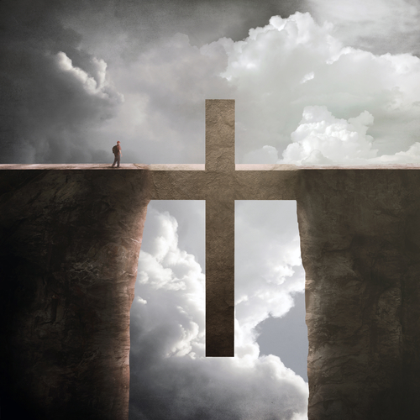
BAPTISM—A Work Of God!
True Gospel:
GRACE
FAI H
BAPTISM
ROMANS 5:2
“through whom also we have access by faith into this grace …”
ROMANS 6:3
“Or do you not know that as many of us as were baptized into Christ Jesus were baptized into His death?”
ROMANS 6:7
“For he who has died has been freed from sin.”

Slide 19
BAPTISM—A Work Of God!
True Gospel:
Colossians 2:12, 13:
¹² buried with Him in baptism, in which you also were raised with Him through faith in the working of God, who raised Him from the dead.
¹³ And you, being dead in your trespasses and the uncircumcision of your flesh, He has made alive together with Him, having forgiven you all trespasses
WHEN WE ARE BAPTIZED, WE ARE JUSTIFIED BY FAITH!

