Slide 1
Theme Of The Bible
“The Redemption Of Man From Sin”
Section VIII: Genesis 12; 13
(Promise to Abram)
All verses from the NKJV unless noted.

Slide 2
Minor Review
Creation of all things within six literal days
(Gen. 1, 2)
  Man and woman made in the image of God
The curse of Sin (Gen. 3-11)
  Sin separates man from God
  Sin brings forth death
  Sin separates man from his fellow man
  Sin separates man from his natural environment
  Sin is universal
  Sin is recurrent
  Sin brings social disruption

Slide 3
Sin Is The Problem!
Man Cannot Solve It By Himself!

Slide 4
THEME:
The Redemption of Man From Sin

Slide 5
Second Key Passage
Genesis 12:1-3 – A Promise To Abraham
  The beginning of the solution to sin
  The beginning of the counter to sin’s effects
  All the rest of the Bible is about fulfilling this promise
  Should commonly ask, “How does this passage relate to the promise to Abraham?”

Slide 6
Genesis 12:1-3
Now the LORD had said to Abram: "Get out of your country, From your family And from your father’s house, To a land that I will show you.
Faith (Heb. 11:8-10)
A land-promise (12:5-7)

Slide 7
Genesis 12:1-3
I will make you a great nation; I will bless you And make your name great; And you shall be a blessing.
Faith (Heb. 11:8-10)
A land-promise (12:5-7)
A nation-promise (18:17. 18)
A name-promise
A blessing as opposed to a curse

Slide 8
Genesis 12:1-3
I will bless those who bless you, And I will curse him who curses you; And in you all the families of the earth shall be blessed."
Faith (Heb. 11:8-10)
A land-promise (12:5-7)
A nation-promise (18:17. 18)
A name-promise
A blessing as opposed to a curse
A protection-promise
A seed-promise where all families are blessed (22:18; Gal. 3:15-16, 29)
“In your seed all the nations of the earth shall be blessed, because you have obeyed My voice” (Gen. 22:18)

Slide 9
Genesis 12:1-3
I will bless those who bless you, And I will curse him who curses you; And in you all the families of the earth shall be blessed."
17:4, 5, “As for Me, behold, My covenant is with you, and you shall be a father of many nations. No longer shall your name be called Abram, but your name shall be Abraham; for I have made you a father of many nations.”
“In your seed all the nations of the earth shall be blessed, because you have obeyed My voice” (Gen. 22:18)
A seed-promise where all families are blessed (22:18; Gal. 3:15-16, 29)

Slide 10
The Three Main Points Promised
Land
Nation
Seed

Slide 11
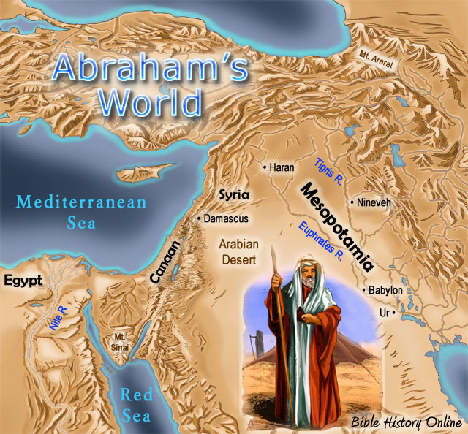
www.bible-history.com/maps/6-abrahams-world-icons.jpg

Slide 12
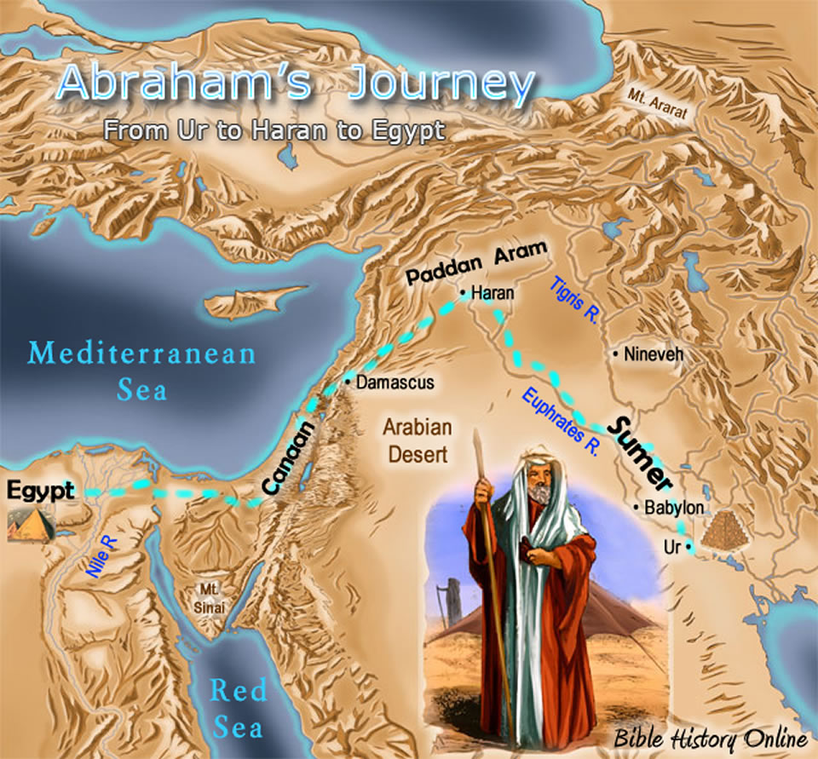
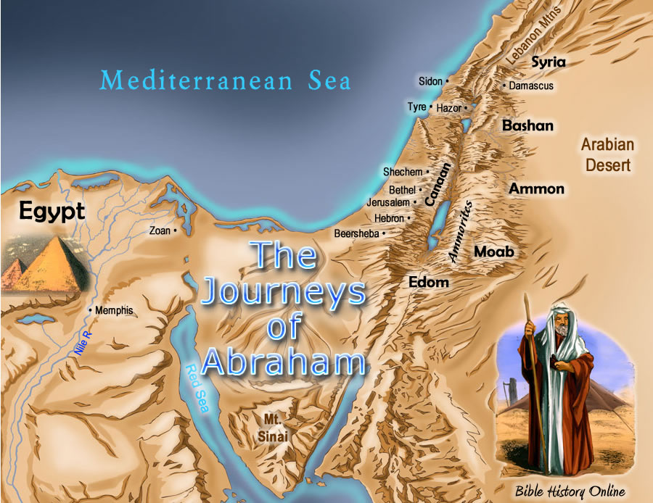
Abram’s Journey
www.bible-history.com/maps/4-Abraham-journey-2l.jpg

Slide 13
www.bible-history.com/maps/6-Abraham-journeys-9l.jpg

