Slide 1
Theme Of The Bible
“The Redemption Of Man From Sin”
Section VI: Genesis 8, 9
(Receding Water and Covenant)
All verses from the NKJV unless noted.

Slide 2
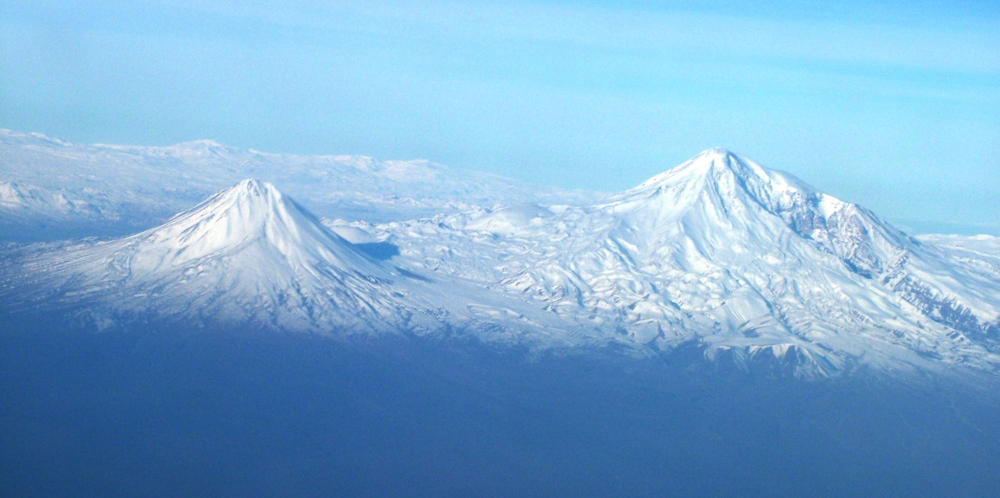
Mountains of Ararat
“Then the ark rested in the seventh month, the seventeenth day of the month, on the mountains of Ararat” (Gen. 8:4)
Wikipedia commons

Slide 3
Genesis 8:1-5
To make the waters recede:
  Wind to pass over the earth
  Fountains of deep and windows of heaven stopped
  Valleys sank and mountains rose:
  “(The mountains rose, the valleys sank down) Unto the place which thou hadst founded for them. Thou hast set a bound that they may not pass over; That they turn not again to cover the earth” (Ps. 104:8, 9, ASV)

Slide 4
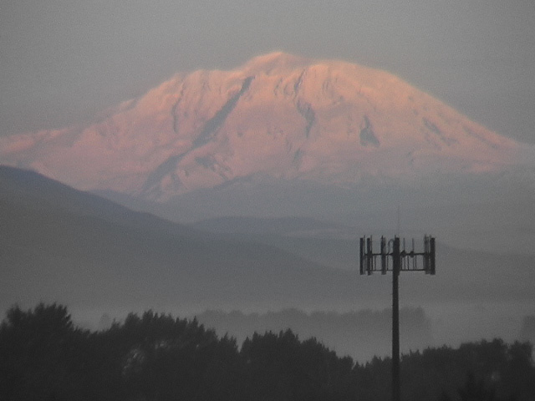
Physical Changes After The Flood
Less land surface (rugged terrain, higher mountains)
Larger and deeper oceans
Latitudinal changes (polar regions, tropical rain forests and barren deserts, etc.)
Weather changes (rain, snow and wind)
Tremendous inland lakes, rivers and glaciers
Increased radiation
PHOTO: Steven J. Wallace

Slide 5
Henry Morris
Depending on topography, vast interior continental lakes would exist for a time and great rivers would form, scouring out great canyons rapidly and depositing tremendous amounts of alluvium in their lower courses. It is significant that, all over the world, interior lakes and seas show evidence of much higher water levels in the recent past. Rivers also everywhere show that they once carried much greater quantities of water and sediment than they do at present. These and related phenomena provide still further geologic evidence of a worldwide flood several thousand years ago” (Genesis Record, p. 208)

Slide 6
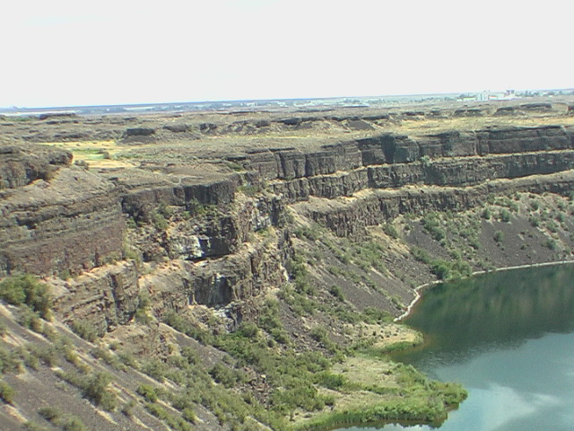
Dry Falls
Dry Falls, Washington State
PHOTO: Steven J. Wallace
Notes:
This is Dry Falls. It is about a 400 foot drop of rock which once used to be a waterfall. It would have been around 4 times larger than Niagara Falls.

Slide 7
only a portion of the ghost falls are seen here
ZOOMED OUT
flow rate: ~65 miles p/hour
PHOTO: Steven J. Wallace

Slide 8
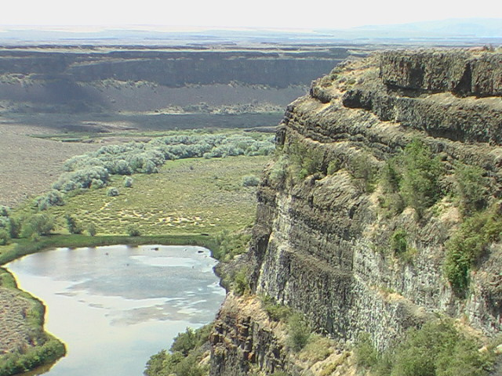
PHOTO: Steven J. Wallace

Slide 9
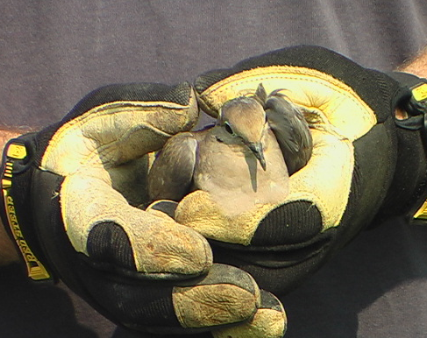
Genesis 8:6-12
Clean and Unclean
  Raven – went to and fro until the waters had dried up
  Dove – found no resting place for the sole of her foot
“But the dove found no resting place for the sole of her foot, and she returned into the ark to him, for the waters were on the face of the whole earth. So he put out his hand and took her, and drew her into the ark to himself” (Gen. 8:9)
Notes:
Matthew Poole wrote, “a fit messenger for that purpose, because it smells dead carcasses at a great distance, and flies far, and then returneth to its former habitation with something in its bill.” The raven would likely grab some part of carrion and bring it back or find some place to eat it.
The dove however is a clean animal. It does not feast upon decaying carcasses. These two kinds of birds can easily represent to mentalities. One which feeds on uncleanness and the other with will not touch it even with the sole of her foot (cf. Rom. 8:5-14). The dove has become a symbol of purity and peace (Ps. 68:13; Song 6:9; Matt. 3:16). It is something that is considered harmless (Matt. 10:16).

Slide 10
Genesis 8:20-22
Noah worships God
  “There is something exceedingly beautiful and interesting to know that the first care of this devout patriarch was to return thanks for the signal instance of mercy and goodness which he and his family had experienced” (JFB)
“While the earth remains” (8:22)
  The earth will not remain forever (2 Pet. 3:7-10)

Slide 11
Genesis 9:1-7
Fear and dread (9:2)
  Terror usually fills the animal kingdom in the presence of men even today
  Others are domesticated for service (Jas. 3:7)
  Shows a dominion of man though different than what Adam had
Given into mans control and placed entirely to his disposal
  Man is not an animal!

Slide 12
Genesis 9:1-7
May eat anything (9:3; cf. Gen. 1:29, 30)
Must abstain from eating blood (9:4; Lev. 17:10, 11; Acts 15:20, 29)
Death penalty enjoined (9:5, 6; Ezek. 13:19; Acts 25:11; Rom. 13:1-4)
  Government authorized
  A system to judge whether one is innocent or guilty of crimes worthy of death

Slide 13
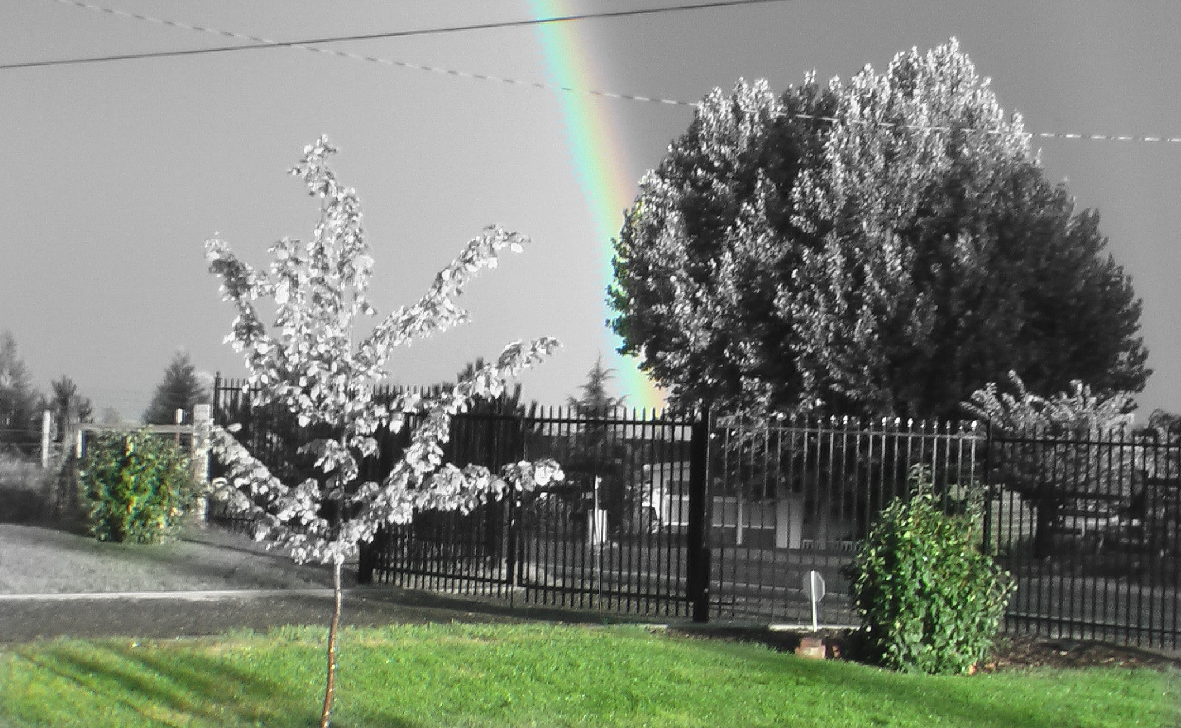
The Rainbow Covenant
Genesis 9:9-17
  Given for all men (9:9, 11, 17)
  Between God and the earth (contrast Sabbath Ex. 31:17)
Notes:
Rainbow “in the cloud” (9:13)
Evidence that it did not rain before
How many observe the beauty of the rainbow but not the covenant?
Seven times “covenant” is used

Slide 14
Sin (Gen. 9:18-29)
The recurring quality of sin…
Adam-Noah comparisons
  Both were commanded to fill the earth
  Both are the ancestors of every living person today
  Both sinned with fruit
  Both were naked and needed a covering
  Both were covered by someone else
Notes:
Prophetic against the Canaanites (Gen. 10:15-20).
Other notes: if there are no gaps, which there probably are, then Noah died when Abraham was about 58 years old.

Slide 15
Sin (Gen. 9:18-29)
Sin begets sin (9:22)
  Should have covered his father instead of broadcasting the news to his brothers
  Love does not rejoice in iniquity (1 Cor. 13:6)
  Ham cursed through Canaan being cursed
Notes:
Prophetic against the Canaanites (Gen. 10:15-20).
Other notes: if there are no gaps, which there probably are, then Noah died when Abraham was about 58 years old.

