Slide 1
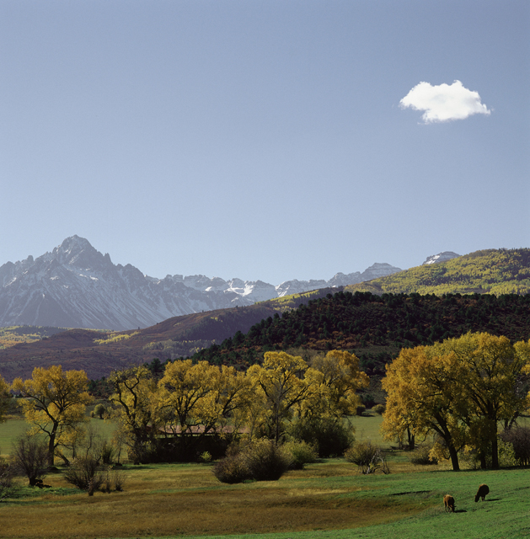
Pursuing Joy & Peace
Is It God’s Will For Me To Be Happy?
Part 2

Slide 2

Anxiety: The Joy Killer
“Anxiety in the heart of man causes depression, But a good word makes it glad.”
Proverbs 12:25

Slide 3

SIN Highjacks Joy
Personal sin (Ps. 31:9, 10; 40:12)
  Repent (Ps. 32:1-7)
  Trust in God’s mercy (Ps. 31:1, 2, 7, 8)
The sins of others (Ps. 31:11-13)
  Trust in the Lord’s deliverance (31:14-20)

Slide 4

Three helps In
Finding The Joy Of THE Lord

Slide 5
1 Thessalonians 5:16-19
16 Rejoice always,
17 pray without ceasing,
18 in everything give thanks; for this is the will of God in Christ Jesus for you.
19 Do not quench the Spirit.

Slide 6

1. Pray Without Ceasing
Seize prayer… seize peace and happiness
Place concerns into God’s hands
(Phil. 4:6, 7)
  God’s prescription!

Slide 7

1. Pray Without Ceasing
Continued and steadfast communication with God throughout your daily living (Rom. 12:12)
Persistent prayer over that which troubles (Lk. 18:1; Col. 4:2; Rom. 12:12)
Pray about everything (Phil. 4:6)

Slide 8
James 4:1-4 (GWV)
1 What causes fights and quarrels among you? Aren’t they caused by the selfish desires that fight to control you?
2 You want what you don’t have, so you commit murder. You’re determined to have things, but you can’t get what you want. You quarrel and fight. You don’t have the things you want, because you don’t pray for them.

Slide 9
James 4:1-4 (GWV)
3 When you pray for things, you don’t get them because you want them for the wrong reason—for your own pleasure.
4 You unfaithful people! Don’t you know that love for this evil world is hatred toward God? Whoever wants to be a friend of this world is an enemy of God.

Slide 10
1 Thessalonians 5:16-19
16 Rejoice always,
17 pray without ceasing,
18 in everything give thanks; for this is the will of God in Christ Jesus for you.
19 Do not quench the Spirit.

Slide 11
2. In Everything Give Thanks
Giving thanks properly honors the Giver
It points the mind to happy thoughts
  It’s hard to be “depressed” and “thankful” at the same time
Giving thanks would require:
  That we recognize we received something good
  That we recognize the value in the thing received
  That we take notice of something from the Lord

Slide 12

2. In Everything Give Thanks
Is it possible to give God thanks
for everything?
  We often look for the negative when we could look to what we can be thankful in
    There could be 20 things right in life and we focus on the 2 things that are not!
    What is right with your life?

Slide 13
Practice Being Thankful In EVERYTHING

Slide 14
1 Thessalonians 5:16-19
16 Rejoice always,
17 pray without ceasing,
18 in everything give thanks; for this is the will of God in Christ Jesus for you.
19 Do not quench the Spirit.

Slide 15

3. Do Not Quench The Spirit
We are to obey the Spirit, walk by the Spirit, and have the fruit of the Spirit (Acts 5:32; Gal. 5:22-26)
Quench: extinguish, to go out, suppress, stifle

Slide 16
3. Do Not Quench The Spirit
1 Thessalonians 5:20-22
Do Not Despise Prophecies (5:20)
The Spirit revealed truth through the prophets
Cannot find the Lord’s happiness while despising His word

Slide 17
3. Do Not Quench The Spirit
1 Thessalonians 5:20-22
Test All Things (5:21)
Many false prophets would come (1 Jn. 4:1)
Testing would require that you are open to hear, consider, and inspect the teaching (Acts 17:11)

Slide 18
3. Do Not Quench The Spirit
1 Thessalonians 5:20-22
Hold Fast (5:22)
Cling to what is good
Because what is truly good has come from God and is worth holding on to (Jas. 1:17; Prov. 23:23)

Slide 19
3. Do Not Quench The Spirit
1 Thessalonians 5:20-22
Abstain from every form of evil (5:22)
“Beloved, I beg you as sojourners and pilgrims, abstain from fleshly lusts which war against the soul” (1 Pet. 2:11)

Slide 20

Happiness and peace will not come by compromising with any “form” (shape, kind, appearance, figure) of evil
Compromise will ultimately bring heartbreak
Do NOT quench the Spirit!
Like pouring water on a fire

Slide 21
1 Thessalonians 5:16-23
16 Rejoice always,
17 pray without ceasing,
18 in everything give thanks; for this is the will of God in Christ Jesus for you.
19 Do not quench the Spirit.
20 Do not despise prophecies.
21 Test all things; hold fast what is good.
22 Abstain from every form of evil.
23 Now may the God of peace Himself sanctify you completely; and may your whole spirit, soul, and body be preserved blameless at the coming of our Lord Jesus Christ.

