Slide 1
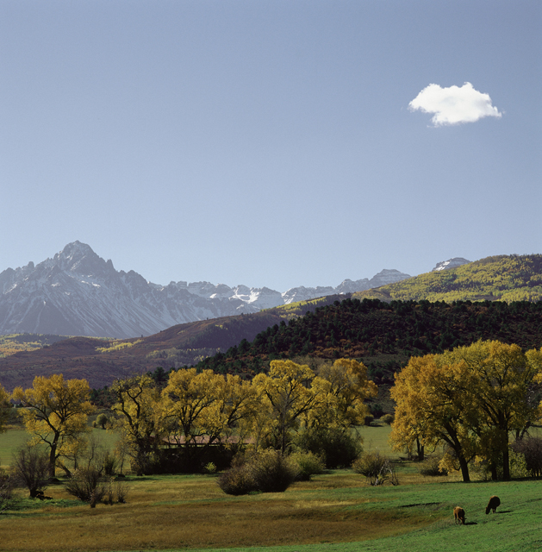
Pursuing Joy & Peace
Is It God’s Will For Me To Be Happy?
Part 1

Slide 3
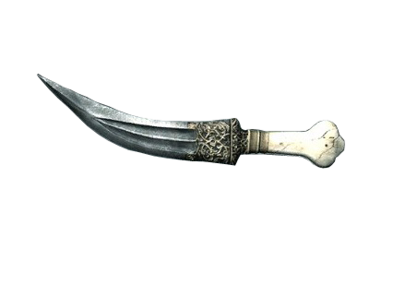
“But Life Has Harsh Realities”
(sickness, unemployment, catastrophic weather, death, violence, infidelity, etc.)

Slide 4
Deuteronomy 16:11
“You shall rejoice before the LORD your God, you and your son and your daughter, your male servant and your female servant, the Levite who is within your gates, the stranger and the fatherless and the widow who are among you, at the place where the LORD your God chooses to make His name abide.”

Slide 6
Psalm 116:1-19
My Devotion
My Distress
My Deliverance
116:1, 2
116:3
116:4-8

Slide 7
Psalm 116:1-19
My Devotion
My Distress
My Deliverance
My Decision
My Delight
116:1, 2
116:3
116:4-8
116:9-14
116:15-19

Slide 8
Psalm 5:11
“But let all those rejoice who put their trust in You; Let them ever shout for joy, because You defend them; Let those also who love Your name Be joyful in You.”

