Slide 1
REVELATION 15-16
SEVEN BOWLS OF WRATH

Slide 2
PRELIMINARY NOTES
in last 3 chapters God identifies the spiritual reasons for the battle
identifies the foe: the devil (Satan)
declares the winner: Jesus and the faithful
the losers: thrown into the winepress of the wrath of God
chapter 15 is the prelude to the seven bowls of wrath

Slide 3
Outline of What is to Come:
seven bowls are revealed in chapter 16
Babylon is destroyed in chapter 17, 18
Jesus is praised as victor in chapter 19, 20:1-10
final judgment scene of the entire world and the entrance of a new heaven and earth in 20:11 – 22:5
final words of assurance and warning 22:6-21

Slide 4
15:1 (the last plagues)
another sign in heaven
  should strike us how much “Revelation” impresses upon the reader that this is a “book of signs”
  there is no excuse for literal approaches
Question 1
  the seven last plagues are the Lord’s completed wrath against the wicked

Slide 5
VICTORIOUS SAINTS (15:2-4)
“SEA OF GLASS”
  NOT LITERAL
  SYMBOLIC OF THE BARRIER BEFORE HEAVEN (4:6; 21:18)
“MINGLED WITH FIRE”
  PERHAPS OF THE SAINTS WHO ENDURED THE FIERY TESTING ON EARTH (1 Pet. 1:7; 4:12)
    …OR THE NATURE OF GOD (Deut. 4:24)

Slide 6
SAINTS HAVE THE VICTORY!
NO ONE ELSE IN N.T. CAN HAVE THE VICTORY EXCEPT THE SAINTS
THE POINT OF THE ENTIRE BIBLE!
  those redeemed have the victory

Slide 7
If we gain victory in business, sports, family life, and in social areas, yet fail in the conquest against our soul, we are losers and not winners!
These saints OVERCAME the beast, the image, the mark, and the number!

Slide 8
The Significance of Worship
Question 2
Many believe worship is a waste of time
Revelation emphasizes worship as the key to faithfulness to God and working against the world’s problems
  Preparing for the seals (4:8-11; 5:8-14)
  Before the trumpets (8:3, 4)
  Before the bowls (15:3, 4)

Slide 9
SAINTS SING
SONG OF MOSES? (question 3)
  Overcoming Egypt, deliverance, salvation (Exodus 14:31-15:3, 13)
Song of the lamb? (Question 4)
  Redemption from sin
  Victory over the beast (12:11; 14:3)
Focus of song is on the Lord!
  No self-focus

Slide 10
REVELATION 14:4
“. . .These are the ones who follow the Lamb wherever He goes. These were redeemed from among men, being firstfruits to God and to the Lamb.”
VICTORY!

Slide 11
“Great and Marvelous Are Your Works, Lord God Almighty” (15:3)
GOD HAS A RECORD OF DOING MARVELOUS THINGS
  “Who is like You, O LORD, among the gods? Who is like You, glorious in holiness, Fearful in praises, doing wonders?” (Ex. 15:11).

Slide 12
“Just and True Are Your Ways, O King of the Saints!” (15:3)
ALL OF GOD’S WAYS ARE “JUST” AND “TRUE”
  WHEN HE JUDGES THE WICKED, HE IS JUST AND TRUE (16:5-7)
  “He is the Rock, His work is perfect; For all His ways are justice, a God of truth and without injustice; righteous and upright is He” (Deut. 32:4)

Slide 13
“Who Shall Not Fear You, O Lord, and Glorify Your Name?” (15:4)
Question 5
  Fear God and glorify His name
A rhetorical question
  Exodus 15:14-16; Deuteronomy 32:39ff; Ecclesiastes 12:13, 14; Jeremiah 10:17

Slide 14

WHO SHOULD YOU REALLY FEAR?
“The LORD is on my side; I will not fear: what can man do unto me?” (Ps. 118:6)

Slide 15
“For You Alone Are Holy. For All Nations Shall Come and Worship Before You, for Your Judgments Have Been Manifested” (15:4)
Deuteronomy 32:21, 43
Jeremiah 16:19, “O LORD, my strength and my fortress, My refuge in the day of affliction, The Gentiles shall come to You From the ends of the earth and say, ‘Surely our fathers have inherited lies, worthlessness and unprofitable things.’”

Slide 16
TEMPLE HAPPENINGS 15:5-8
LOOKS UP AND SEES 7 ANGELS COMING OUT OF TEMPLE
ARRAYED IN PURE BRIGHT LINEN
GOLDEN BANDS

Slide 17
TEMPLE HAPPENINGS 15:5-8
ANGELS RECEIVE SEVEN BOWLS OF WRATH – GOD’S COMPLETE FURY
TEMPLE FILLED WITH SMOKE

Slide 18
DOOM AND GLOOM TO SINNERS!
(Time For Repentance Can Expire)
Jeremiah 15:1, “Then said the LORD unto me, though Moses and Samuel stood before me, yet my mind could not be toward this people: cast them out of my sight, and let them go forth.”
Lamentations 3:44, “Thou hast covered thyself with a cloud, that our prayer should not pass through.”

Slide 19
CHAPTER 16
7 BOWLS OF WRATH

Slide 20
FIRST BOWL (16:1, 2) question 6
BOWLS OF WRATH FLOW PARALLEL TO TRUMPETS
SEVEN:
  SEALS –REVEAL
  TRUMPETS –ANNOUNCE
  BOWLS -EXECUTE
THE “SEVEN SERIES” DIVIDED INTO THREE GROUPS (4) (2) (1)

Slide 21
TRUMPETS
BOWLS
1ST | hail, fire-earth | poured on earth
2ND | great mountain sea | poured on sea-blood
3RD | star fell on fresh water | poured on fresh water
4TH | affects sun, moon, stars | poured on sun, scorched people
5TH | sun, air darkened, people tormented | kingdom became darkness, pain
6TH | 4 angels @ Euphrates | Euphrates dried up-kings
7TH | world kingdoms become Lord’s, great noises, etc. | “It is done,” great noises, etc.

Slide 22
DIFFERENCE BETWEEN THE TRUMPETS & BOWLS
TRUMPETS AFFECTED 1/3rd
  Primarily disciplinary
  To call men to repentance (2 Pet. 3:9)
BOWLS FULLY AFFECTED
  Higher intensity
  Primarily to punish men for not repenting

Slide 23
FIRST BOWL (16:2)
FOUL & LOATHSOME SORE CAME UPON THOSE WITH THE MARK OF THE BEAST
  DIRECT ON MAN
  DISTINCTION BETWEEN PEOPLE
  DEMONSTRATES GOD’S DELIVERANCE
    LIKE HIS PEOPLE OUT OF EGYPT SO HE WILL DELIVER HIS PEOPLE HERE (cf. Ex. 9:8-11)

Slide 24
SECOND BOWL (16:3)
SIMILAR TO GOD’S JUDGMENT ON EGYPT
“Then the LORD spoke to Moses, ‘Say to Aaron, “Take your rod and stretch out your hand over the waters of Egypt, over their streams, over their rivers, over their ponds, and over all their pools of water, that they may become blood. And there shall be blood throughout all the land of Egypt, both in buckets of wood and pitchers of stone”’” (Ex. 7:19)

Slide 25

repulsive
picture a murdered man lying in the pool of his own blood

Slide 26
THIRD BOWL (16:4-7)
AFFECTS THE FRESH WATER
  3rd TRUMPET MADE WATER BITTER (8:10, 11)
  question 7
ROME HAD MADE RIVERS OF BLOOD FLOW FROM PERSECUTING (NT) PROPHETS AND SAINTS
  GOD MAKES THEM REAP WHAT THEY HAVE SOWN
  DRINK BLOOD

Slide 27
THIRD BOWL
GENESIS 9:5, 6
5 "Surely for your lifeblood I will demand a reckoning; from the hand of every beast I will require it, and from the hand of man. From the hand of every man’s brother I will require the life of man.
6 "Whoever sheds man’s blood, By man his blood shall be shed; For in the image of God He made man.

Slide 28

FOURTH BOWL
(16:8, 9)
A blazing and scorching sun
Scorched with great heat
Point: no mercy (Isa. 47:8-15; Jon. 4:6-8)

Slide 29
FOURTH BOWL
(16:8, 9)
LANGUAGE OF VERSE 9 LIKE A FUNERAL DIRGE
  Question 8
  People wax worse
  Crying out to or against God?
  Deserved punishment may harden some

Slide 30
“This shows the depths of their degradation. When a criminal gets to the point where he blames his victim, his parents, society, the courts, and the prison system for his suffering the penalty of his crime rather than seeing himself and his crime as responsible, we call him a hardened criminal. So it is here: these men are hardened sinners, so hardened in fact that repentance is completely absent from their thinking”
HOWARD WINTERS

Slide 31
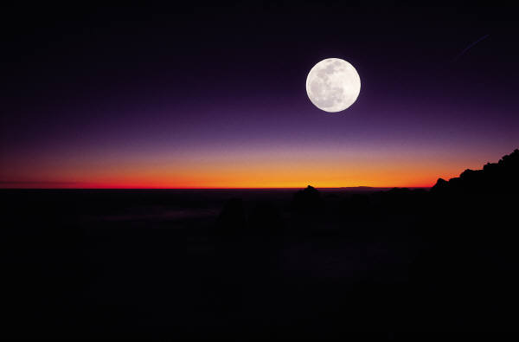
FIFTH BOWL (16:10, 11) question 4
ALLUSION TO PLAGUE OF DARKNESS (Ex. 10:21-23)
  POURED OUT ON THRONE. . .WHOLE KINGDOM BECAME DARK
  IF WALK IN DARKNESS, THEN LIVE IN DARKNESS
  EVENTUALLY THE PLEASURE OF SIN TURNS TO PAIN
  PEOPLE TOO CARNAL TO SEE THEIR OWN ACTIONS AS THE REASON FOR THEIR WRETCHEDNESS

Slide 32
WAGE of SIN
Regardless of how much sin offers, regardless of how much sin promises, it will always and only be fulfilled in the wages of death.

Slide 33
FIFTH BOWL
“This is not usual darkness! This darkness is at the throne of the beast. The beast is Rome, the darkness is at the throne of Rome. One of the most effective ways to destroy a kingdom or a nation is to blind its leaders. Once wisdom or light is removed the nation crumbles. When God decides to punish a nation, He smites the nation with a foolish leader”
J. R. BRONGER

Slide 34
Historian Professor Alexander Tyler, circa 1787, Re: The Fall of the Athenian Republic.
"A democracy cannot exist as a permanent form of government. It can only exist until the voters discover that they can vote themselves largesse (generous gifts) from the public treasury. From that moment on, the majority always votes for the candidates promising the most benefits from the public treasury, with the result that a democracy always collapses over loose fiscal policy, (which is) always followed by a dictatorship."

Slide 35
Historian Professor Alexander Tyler, circa 1787, Re: The Fall of the Athenian Republic.
"The average age of the world's greatest civilization has been two hundred years. These nations have progressed through this sequence: From bondage to spiritual faith; from spiritual faith to great courage; from courage to liberty; from liberty to abundance; from abundance to complacency; from complacency to apathy; from apathy to dependence; from dependence back into bondage."

Slide 36
FOOLS FOR KINGS
“Woe to you, O land, when your king is a child. . .” (Eccl. 10:16)
“Let their eyes be darkened, so that they do not see; and make their loins shake continually” (Ps. 69:23)

Slide 37
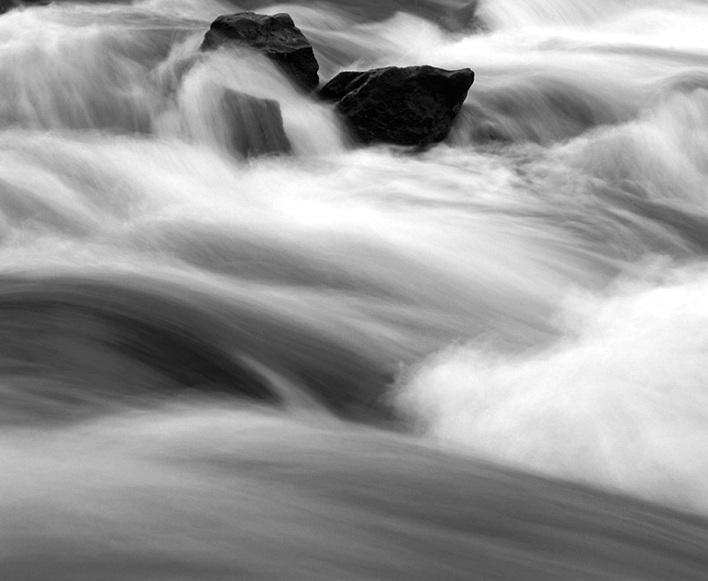
SIXTH BOWL (16:12-16)
REMOVING ALL OBSTACLES FROM ROME’S ENEMIES (v. 12)
SATAN WILL NOT BE PASSIVE IN DEFEAT (vv. 13, 14)
  3 spirits from the dragon (Satan), beast (sea-beast) and the false prophet (land-beast)
  purpose to bolster army

Slide 38
SIXTH BOWL
EXHORTATION TO SAINTS (v. 15)
  Jesus doesn’t announce when his judgment is
  Saints need to be patient in watching and waiting
    remain pure and do not yield to Rome’s temptations

Slide 39
SIXTH BOWL question 10
ARMAGEDDON
  Much vain speculation about
  Not a future battle between Jesus and Satan on earth

Slide 40
ARMAGEDDON
Means hill or city of Megiddo
Found only in this passage
Meaning is established in the history of “Megiddo”

Slide 41
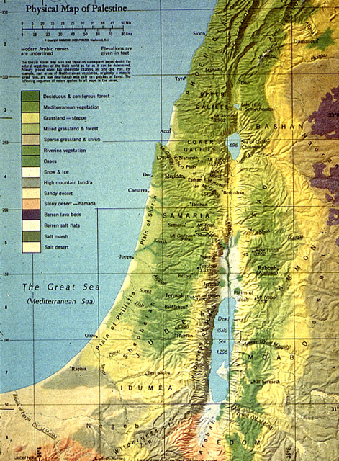
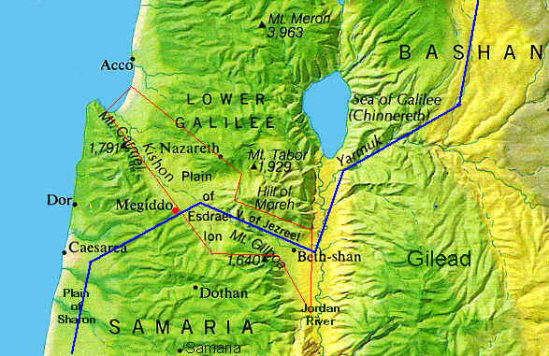
ARMAGEDDON

Slide 42
ARMAGEDDON
WHERE GIDEON’S BROTHERS WERE KILLED (JUD. 8:18, 19)
WHERE BARAK’S MEN CAME UPON SISERA
(JUD. 4:14)

Slide 43
ARMAGEDDON
IS NOT A LITERAL BATTLE AT MEGIDDO
IS NOT A FUTURE BATTLE
IS THE HOLY SPIRIT’S SYMBOL OF A SPIRITUAL PLACE:
  WHERE SATAN SCHEMES AND RECRUITS OTHERS AGAINST GOD
  WHERE THOSE WITHOUT GOD’S APPROVAL ARE DEFEATED

Slide 44

FAMOUS BATTLES
  VICTORY: Battled according to God’s will
    DEBORAH & BARAK OVER SISERA’S MILITARY (Jud. 5:19-21)
  DEFEAT: Battled against God’s will
    JOSIAH WAS KILLED IN BATTLE
    (2 Chron. 35:22-25)

Slide 45
SEVENTH BOWL (16:17-21)
THE EFFECT OF WHAT HAS HAPPENED IS OUTLINED IN “IT IS DONE” (v. 17)
POURED OUT IN THE AIR
  against Satan
  “in which you once walked according to the course of this world, according to the prince of the power of the air, the spirit who now works in the sons of disobedience” (Eph. 2:2)

Slide 46
SEVENTH BOWL
EARTHQUAKE (vv. 18, 19)
  Rome divided into three parts
  DESOLATING THE EMPIRE—”Babylon is Fallen” (14:8)
  “But Jesus knew their thoughts, and said to them: ‘Every kingdom divided against itself is brought to desolation, and every city or house divided against itself will not stand.’” (Matt. 12:25)

Slide 47
SEVENTH BOWL
GOD HAD MADE ROME DRINK OF THE CUP OF HIS FIERCENESS
WHEN DIVIDED, THE NATIONS FELL
THE WHOLE ANTI-CHRISTIAN SYSTEM HAD CRUMBLED
FULFILLMENT OF DANIEL 2:44

Slide 48
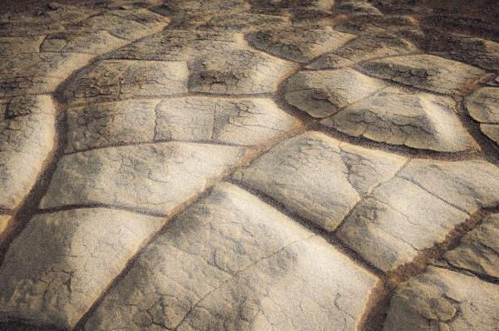
“And in the days of these kings the God of heaven will set up a kingdom which shall never be destroyed; and the kingdom shall not be left to other people; it shall break in pieces and consume all these kingdoms, and it shall stand forever”
Daniel 2:44

Slide 49
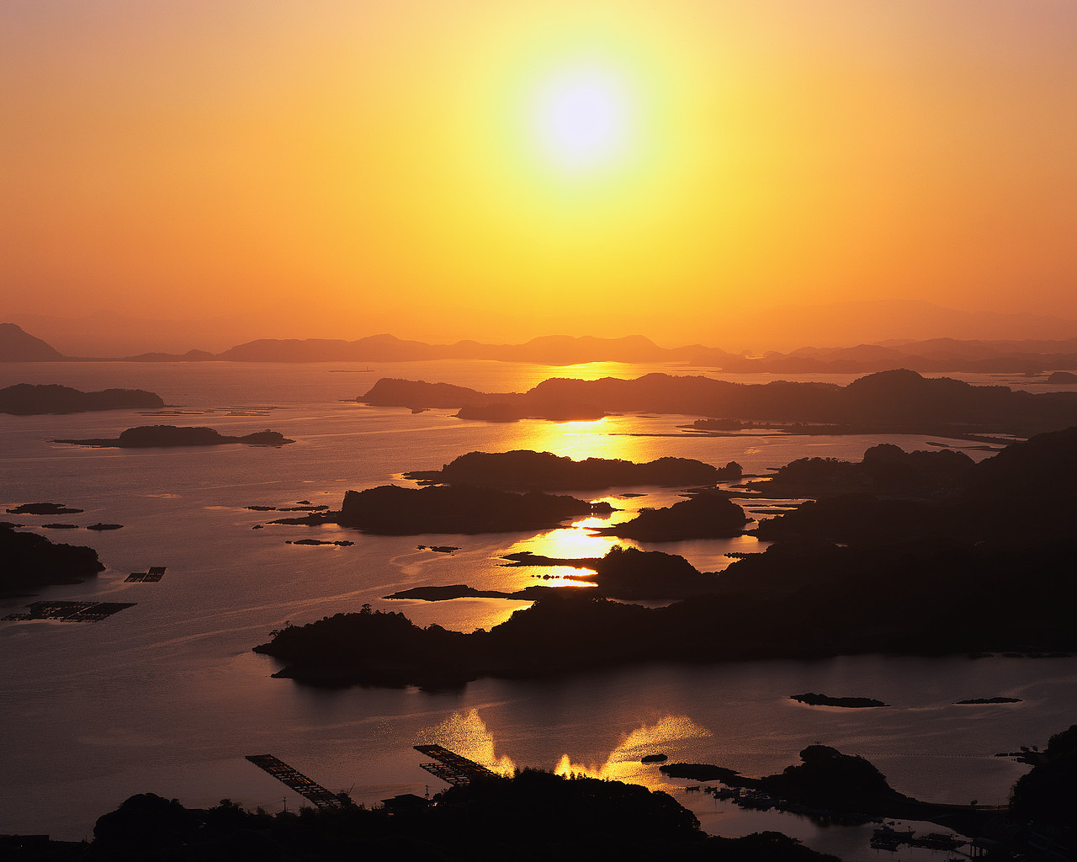
ISLANDS & MOUNTAINS
The islands fled and the mountains (strength) were not found. There was no place of refuge. God “exceedingly” plagued Rome. He took away their health, their water, their pleasure; he scorched them and flung 100 pound hailstones on top of them. All that the people continued to do is curse God (16:21), but their eternal lot is found near the end of the book in the eternal lake of fire.

Slide 50
11. Applications?

Slide 51
Applications:
Rejecting God’s mercy and discipline results in a hardening of the heart (16:9, 11, 21)
“It is a fearful thing to fall into the hands of the living God” (Heb. 10:31)
How terrible it is to have God remember our sins in judgment!

Slide 52
Applications:
God’s punishments are just (Rev. 16:3-7)
Blaspheming God is the wrong prayer when disciplined
God is not mocked

